Slide 1
/winston
// travel-content-skill · pipeline walkthrough
The content pipeline, in action.
What the skill linked in the recovery plan does, end to end: one live run, every step, shown as it happened.
SKILL
RUN
STEPS
OUTPUT
travel-content-skill
2026-09-24
5 + 2 checkpoints
3 pages + 3 locales
travel-content-skill · pipeline walkthrough · september 2026
01

Slide 2
/winston
// the shape of a run
The pipeline at a glance.
Step 1 researches the topic universe and writes a claim ledger: every fact dated, tiered, and sourced.
Step 2 scores the research into a ranked idea slate. Checkpoint 1: the operator keeps, re-researches, or reselects.
Step 3 drafts the kept ideas. Step 4 edits each draft. Step 5 audits each draft against live sources and fixes what fails.
Checkpoint 2: the operator reviews and picks translations. Step 6 translates with a shared termbase.
travel-content-skill · pipeline walkthrough · september 2026
02

Slide 3
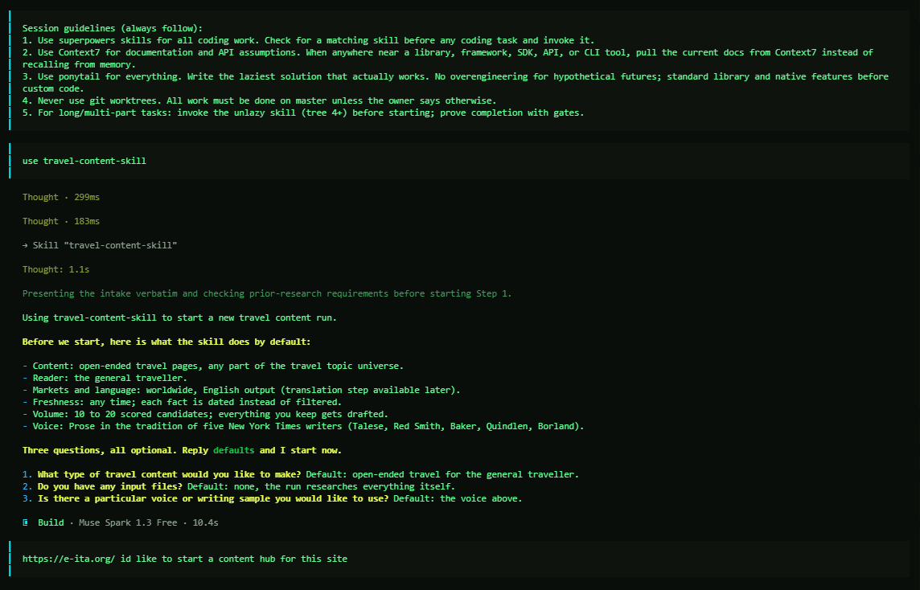
/winston
// intake
Invoke the skill.
One command starts the run. The skill answers with its defaults: content type, reader, markets, freshness, volume, and voice.
Three questions, all optional. The operator names the site and the job: a content hub for e-ita.org.
travel-content-skill · pipeline walkthrough · september 2026
03

Slide 4
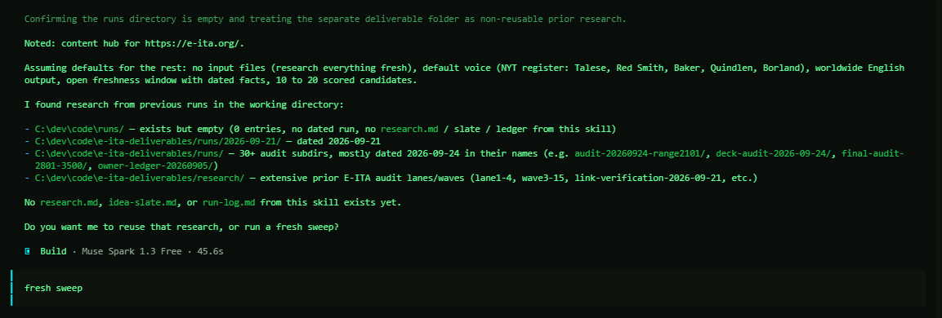
/winston
// intake
Reuse or start fresh.
The skill checks the working directory for prior research and asks before reusing any of it.
This run: a fresh sweep. Nothing stale carries in.
travel-content-skill · pipeline walkthrough · september 2026
04

Slide 5
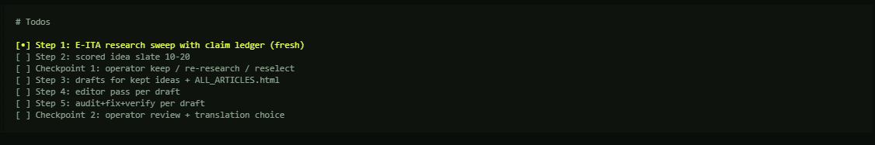
/winston
// the plan
The run is a checklist.
Five steps and two operator checkpoints, tracked from the start.
Nothing advances without its box checked.
travel-content-skill · pipeline walkthrough · september 2026
05

Slide 6
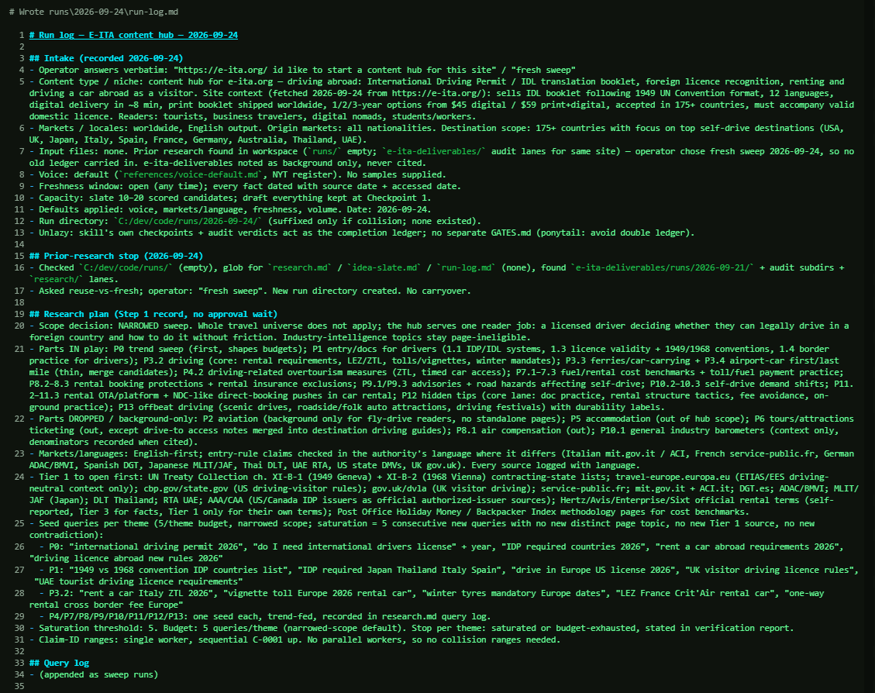
/winston
// step 1 · research
The sweep is planned before it runs.
Every intake answer lands in the run log first. Then the plan: scope, source tiers, seed queries, and the saturation rule that tells the sweep when to stop.
travel-content-skill · pipeline walkthrough · september 2026
06

Slide 7
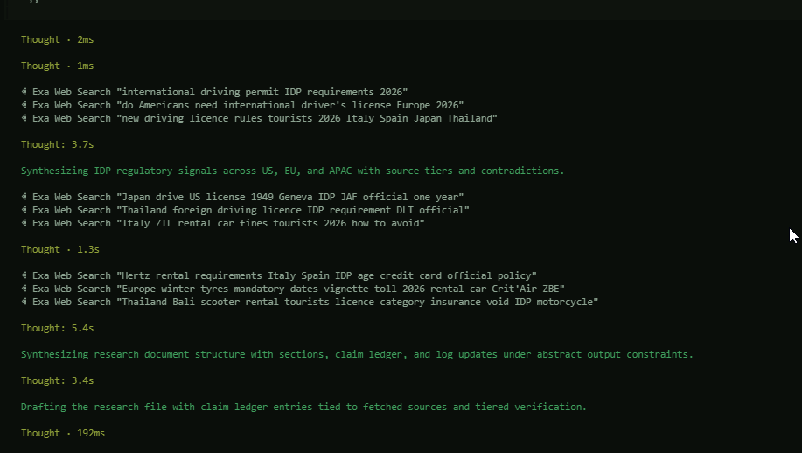
/winston
// step 1 · research
The sweep runs live.
Searches fan out across the topic universe: US, EU, and APAC rules, rental-desk terms, border practice.
Every result is tiered by authority as it lands.
travel-content-skill · pipeline walkthrough · september 2026
07

Slide 8
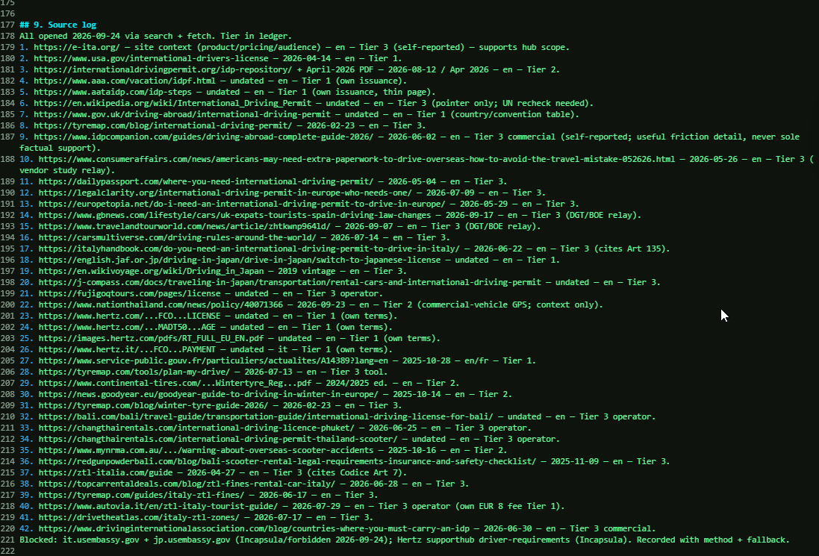
/winston
// step 1 · research
Every source is logged and tiered.
The source log records each URL with its date, language, and tier.
Tier 1 is official issuer and government text. Lower tiers are marked as what they are, never silently trusted.
travel-content-skill · pipeline walkthrough · september 2026
08

Slide 9
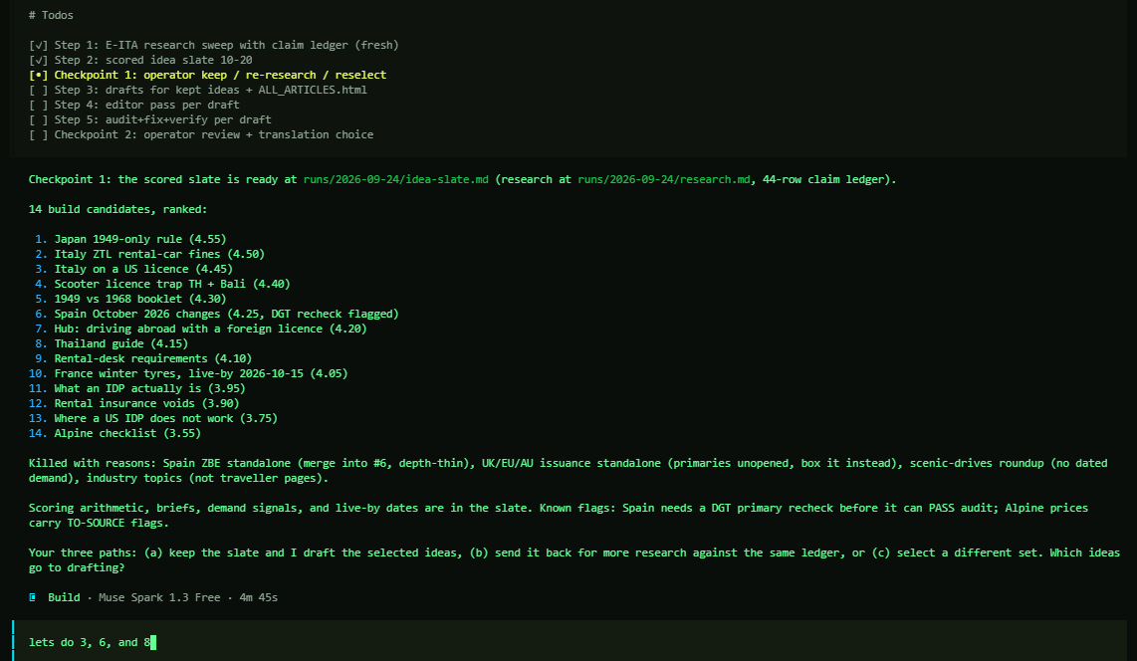
/winston
// checkpoint 1
Research becomes a scored slate.
Fourteen candidate pages, ranked, each with a score and a brief. Weak ideas are killed with reasons, in writing.
The operator picks what gets drafted: 3, 6, and 8.
travel-content-skill · pipeline walkthrough · september 2026
09

Slide 10
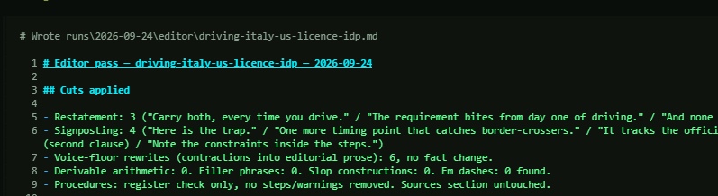
/winston
// step 4 · editor
The editor pass.
Each draft is cut and tightened, with a written record of every change: restatements, signposting, filler.
Voice rewrites never touch a fact. Zero em dashes, verified.
travel-content-skill · pipeline walkthrough · september 2026
10

Slide 11
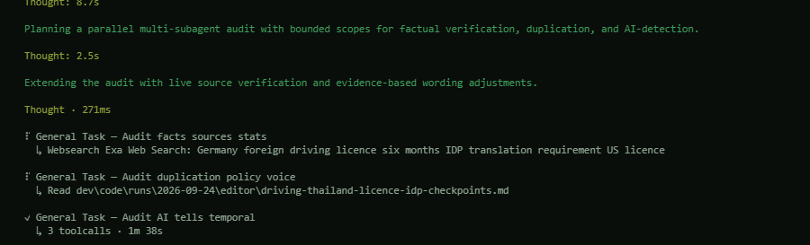
/winston
// step 5 · audit
The audit pass.
Every drafted page is audited in parallel: facts against live sources, duplication and policy, AI-writing tells.
An error the audit catches gets fixed before the page can pass.
travel-content-skill · pipeline walkthrough · september 2026
11

Slide 12
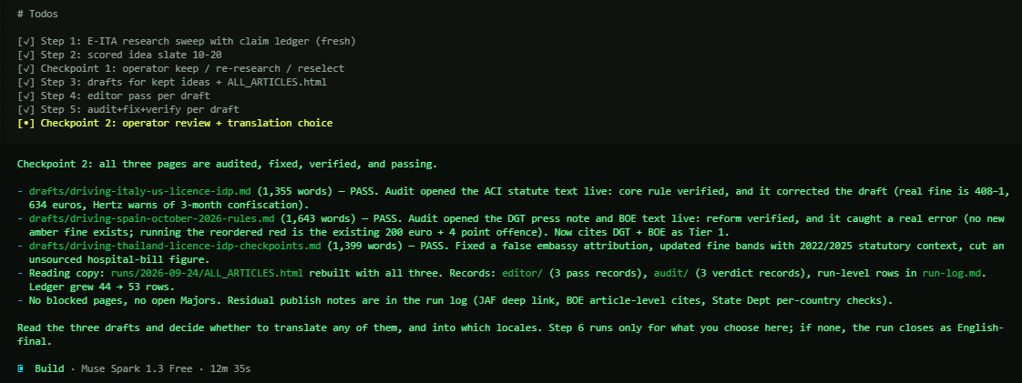
/winston
// checkpoint 2
Pass, or fix and re-audit.
All three pages pass with their audit notes attached: what was verified, what was corrected, what changed.
The operator decides what translates, and into which locales.
travel-content-skill · pipeline walkthrough · september 2026
12

Slide 13
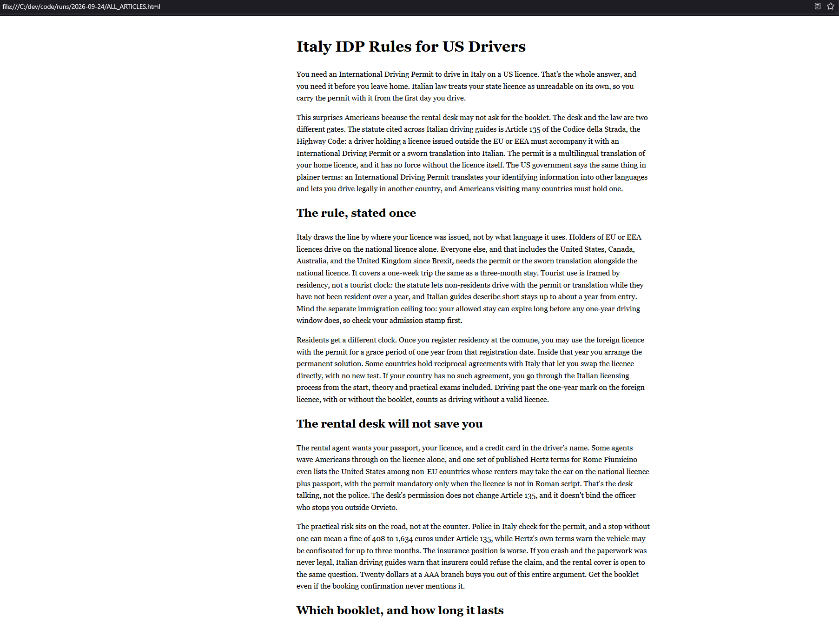
/winston
// the output
The output is the article.
A finished page in ALL_ARTICLES.html: the answer in the first paragraph, sourced prose after it, no padding.
This is the page the pipeline exists to write.
travel-content-skill · pipeline walkthrough · september 2026
13

Slide 14
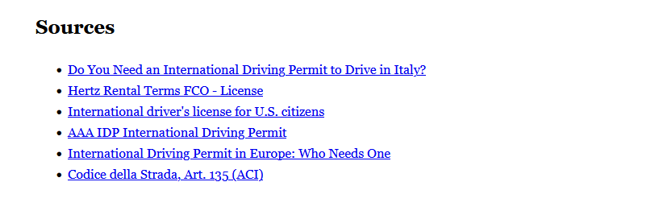
/winston
// the output
Every article ends in its sources.
The citation list is part of the deliverable, not an afterthought.
Each claim in the page traces to one of these.
travel-content-skill · pipeline walkthrough · september 2026
14

Slide 15
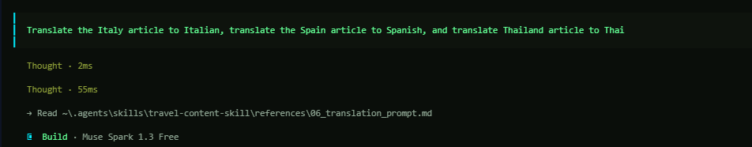
/winston
// step 6 · translation
Translation runs on request.
One instruction covers all three: Italy to Italian, Spain to Spanish, Thailand to Thai.
Official names stay untranslated; formats, dates, and procedures localize.
travel-content-skill · pipeline walkthrough · september 2026
15

Slide 16
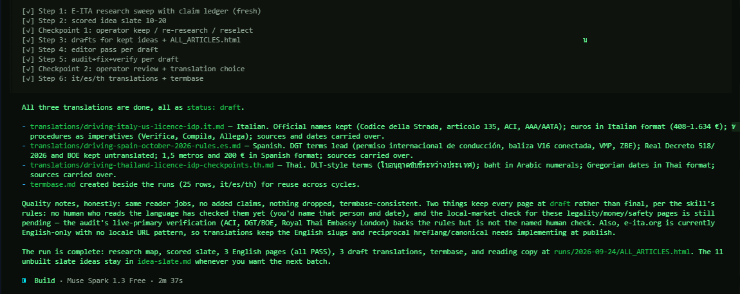
/winston
// run complete
The run closes with a ledger.
Three English pages, all passing. Three draft translations with a shared termbase, marked draft until a fluent reader checks them.
The unbuilt slate ideas stay queued for the next batch.
travel-content-skill · pipeline walkthrough · september 2026
16

Slide 17
/winston
// next run
Run it again next month.
The slate, the ledger, and the termbase carry over. The next run starts from yesterday's work, not from zero.
This is the monthly content cycle the recovery plan links to: research, draft, edit, audit, publish, translate.
travel-content-skill · pipeline walkthrough · september 2026
17

