Slide 1
/winston
// algorithm drop analysis
E-ITA recovery audit.
What broke, when, and what to do with every page. Sixteen months of Search Console, every documented Google update, and every change the site shipped, lined up, then a verdict for every URL.
SITE
WINDOW
REPORT DATE
BREAK DATE
e-ita.org
2025-05-02 to 2026-09-16
2026-09-24
2026-08-21

Slide 2
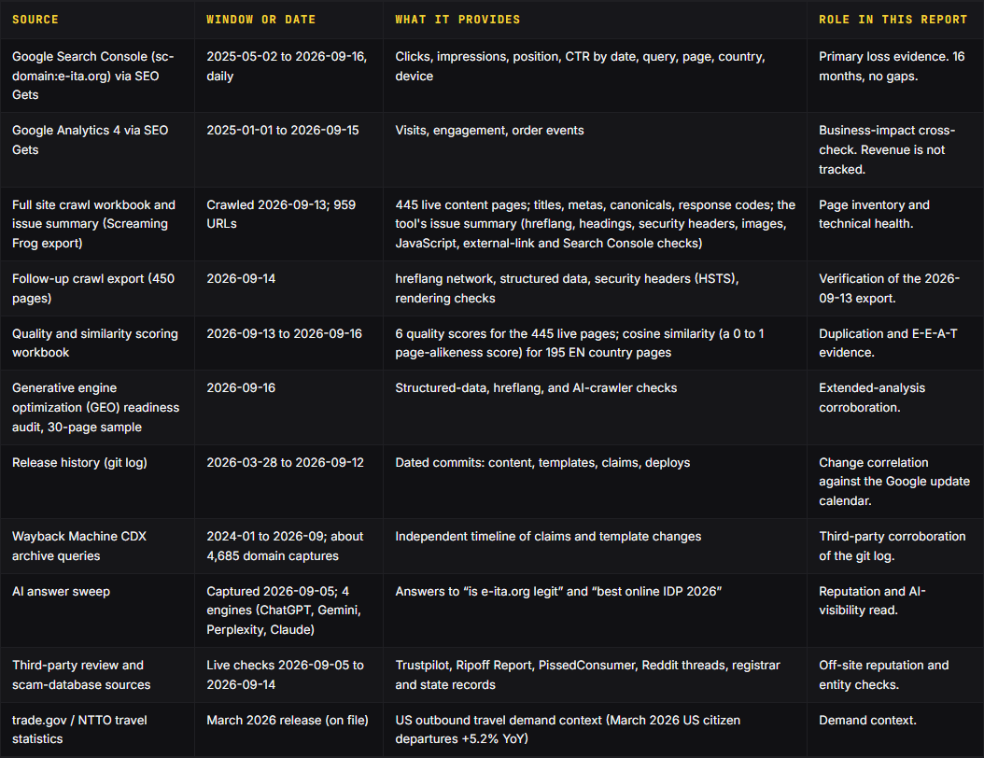
/winston
// how this audit was done
How this audit was done.
Every figure in this deck traces to one of the report's sources. First-party data wins over third-party estimates.
Search Console carries the 16-month daily series (2025-05-02 to 2026-09-16). The 2026-09-13 crawl and the git log supply the page and release record.
e-ita.org · recovery audit · september 2026
02

Slide 3
/winston
// 01 · executive summary
The collapse in four numbers.
-88.8%
organic clicks gone since 2026-08-21
-97.8%
impressions gone, 24,220/day to 527/day
30.9
clicks/day now, vs the 275.5/day plateau
1.0 to 1.6
brand positions held through the collapse
Trigger: a spam classifier re-scored the site on the final day of the August 2026 spam update, 42 to 49 days after the 2026-07-03 to 07-10 re-ship made the pages measurably more uniform (184 of 195 EN country pages above 0.90 similarity).
Cap: thin E-E-A-T and hostile reputation on a YMYL document topic; contributing condition, caps recovery.
e-ita.org · recovery audit · september 2026
03

Slide 4
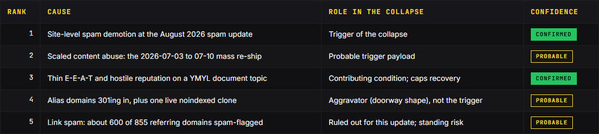
/winston
// 01 · the verdict
Five causes, ranked by evidence.
Rank 1, confirmed: site-level spam demotion at the August 2026 spam update. A one-day step across every class and market, brand intact.
Rank 2, probable: scaled content abuse from the July re-ship. About 255 near-identical indexable pages shipped in one week, 42 to 49 days before the break.
e-ita.org · recovery audit · september 2026
04

Slide 5
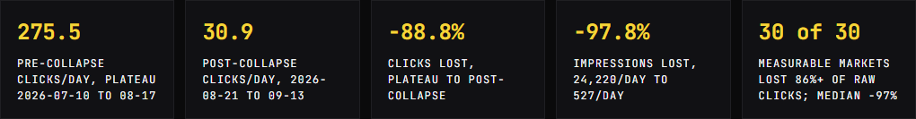
/winston
// 01 · the numbers
The numbers that matter.
Clicks fell 275.5 to 30.9 per day. Impressions fell 24,220 to 527 per day. Position fell 9.1 to 18.9 in one day.
No content class held: every class fell 55% to 97%, and every one of the 30 measurable markets lost at least 86%.
e-ita.org · recovery audit · september 2026
05

Slide 6
/winston
// 01 · the actions
The four actions that matter most.
Freeze the page set. Stop all new pages, new locales, and automated rewrites until the plan ships.
Ship the truth layer in one template deploy. One country list, real validity terms, recycled reviews removed.
Execute the page-by-page plan. Ship the full 357-row map: return 410 for the 162 kill URLs and the 18 retired translations pages, 301 the 155 fold URLs and the 22 legacy and rental-brand URLs, and rewrite the 64 rewrite-bucket pages with named authorship.
Lift the AI block. Whitelist GPTBot, ClaudeBot, and Bytespider at the WAF. Ship Organization schema and llms.txt.
e-ita.org · recovery audit · september 2026
06

Slide 7
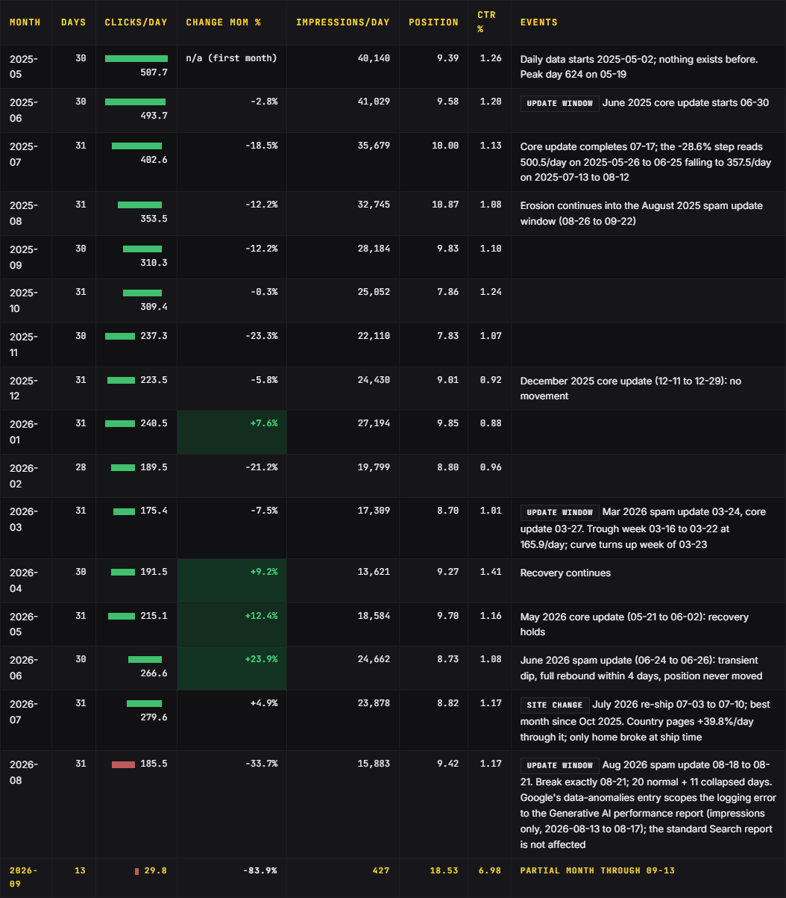
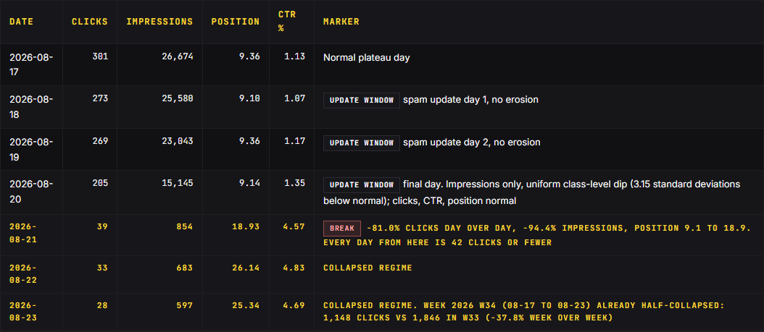
/winston
// 02 · sixteen months
Sixteen months, two breaks.
The 2025 erosion broke inside the June 2025 core update: a -28.6% step, and the site never won it back.
The collapse is one day: 2026-08-21, clicks 205 to 39 and impressions 15,145 to 854.
e-ita.org · recovery audit · september 2026
07

Slide 8
/winston
// 02 · the break day
The break day: 2026-08-21.
The last normal day was 2026-08-20. On 2026-08-21 impressions fell 94.4% and clicks fell 81.0%: the largest day-over-day drop in the 503-day series.
Position kept deteriorating for three days after impressions vanished. The demotion deepened after the break.
e-ita.org · recovery audit · september 2026
08

Slide 9
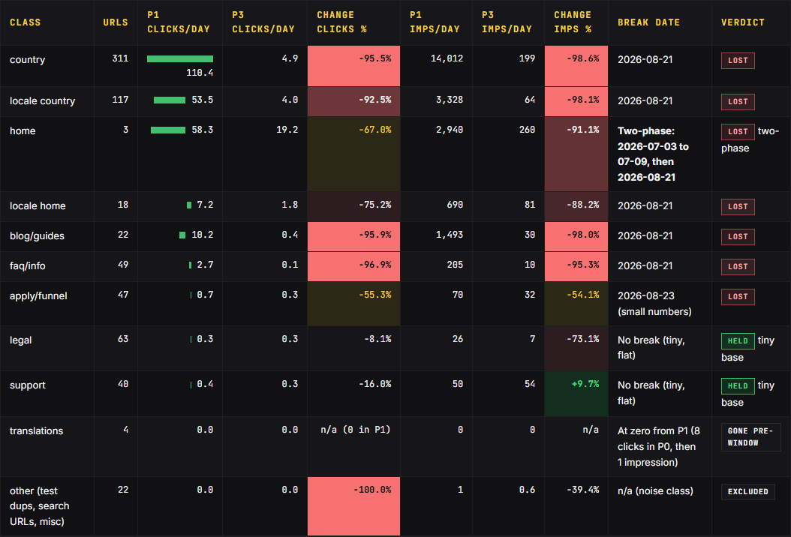
/winston
// 02 · page classes
Which templates lost.
No content class held. Every content class fell 55% to 97% of daily clicks across the break.
Only tiny legal and support classes held, on near-zero bases. The home page is the only two-phase break.
e-ita.org · recovery audit · september 2026
09

Slide 10
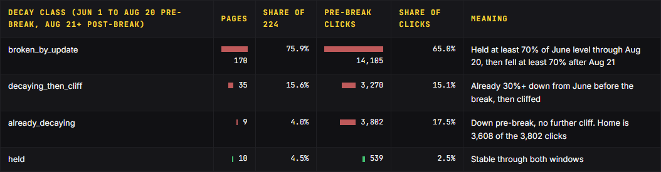
/winston
// 02 · decay split
Broken by the update, not decaying.
75.9% of measurable pages were broken purely by the update, not decaying before it.
The decayed set is small and concentrated: the home page alone carries most of it.
e-ita.org · recovery audit · september 2026
10

Slide 11
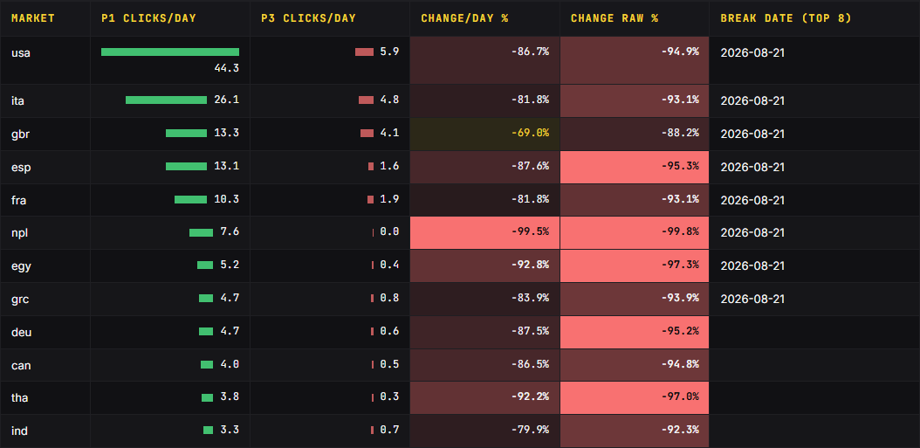
/winston
// 02 · markets
Where the loss landed, market by market.
No market escaped. On raw totals every one of the 30 markets lost at least 86%; the median loss is -97%.
The deepest are Chile -100.0%, Nepal -99.8%, and Pakistan -99.5%. The US sits mid-pack.
e-ita.org · recovery audit · september 2026
11

Slide 12
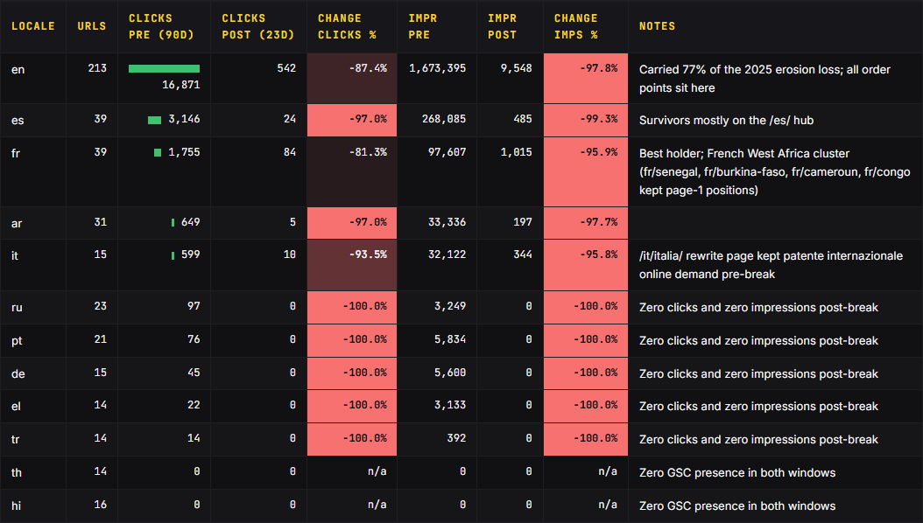
/winston
// 02 · locale
The loss by locale.
English carried the site and carried the loss (-87.4%). All 25 order-bearing pages sit on English pages.
French is the best translated holder: the French West Africa cluster kept page-one positions.
e-ita.org · recovery audit · september 2026
12

Slide 13
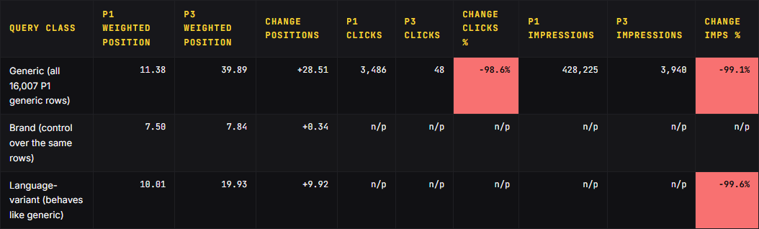
/winston
// 02 · position
Generic demoted, brand intact.
Brand rankings held at positions 1.0 to 1.6. The collapse is position demotion specific to non-brand query classes, not a demand or reporting artifact.
Desktop position collapsed 10.81 to 39.96 while mobile improved. No device was spared.
e-ita.org · recovery audit · september 2026
13

Slide 14
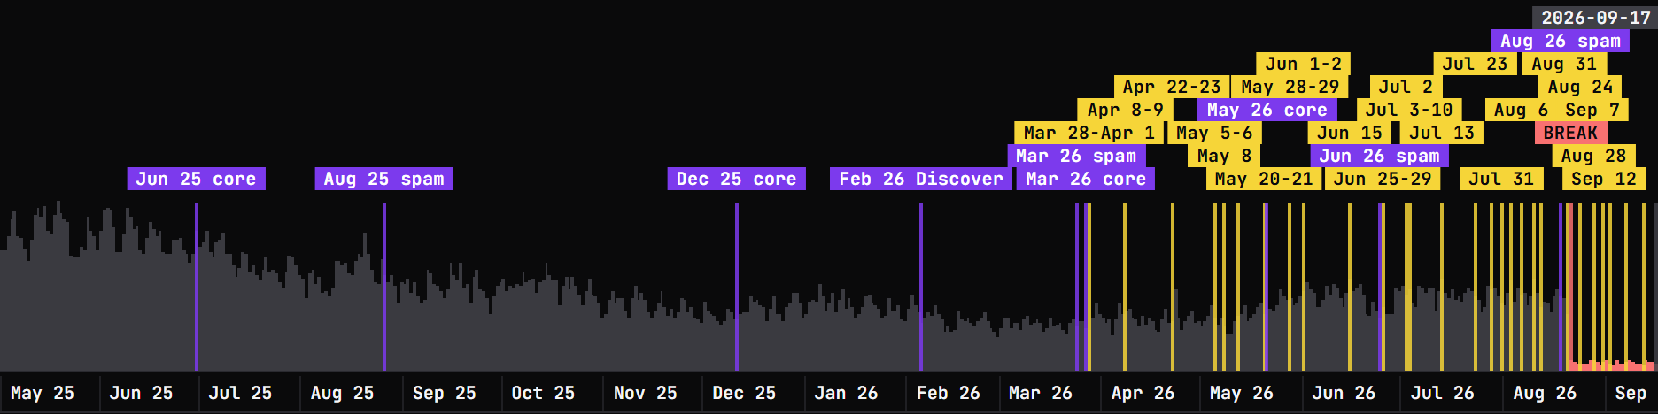
/winston
// 03 · the overlay
503 days, three layers, one chart.
Every day of clicks, every Google update, and every release on one timeline. Nothing moves at ship time except the home page.
The second break lands exactly on the rollout completion day of the August 2026 spam update.
e-ita.org · recovery audit · september 2026
14

Slide 15
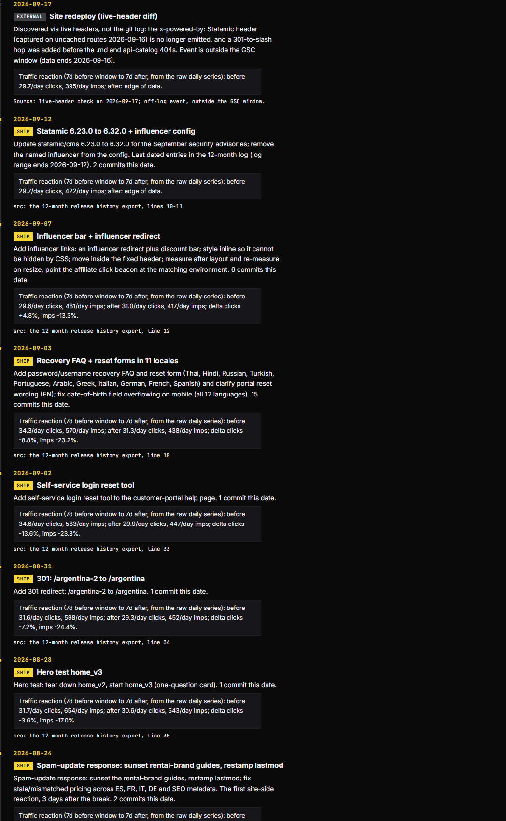
/winston
// 03 · the timeline
9 updates, 56 ship days.
67 events on the timeline: 9 Google updates, 56 ship days, 1 break, 1 external redeploy.
Only three are load-bearing: the June 2025 core update, the July 2026 re-ship, and the August 2026 spam update.
e-ita.org · recovery audit · september 2026
15

Slide 16
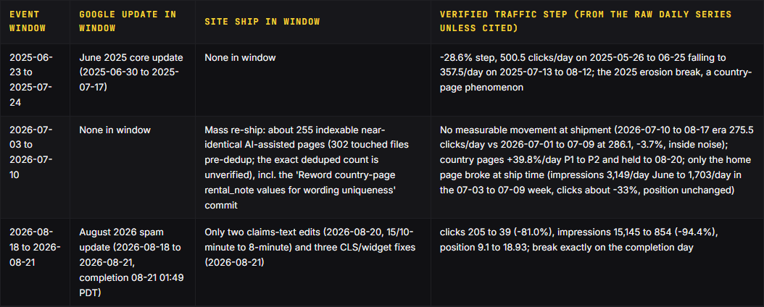
/winston
// 03 · updates vs releases
Algorithm, release, or both.
No measurable movement at the July re-ship: -3.7%, inside noise. Country pages grew +39.8%/day through it and held to 08-20.
The break came 42 to 49 days later, on the classifier refresh. Six weeks of stable traffic is the expected gap.
The verdict: both overlapping. The July re-ship loaded the gun. The August 2026 spam update fired it.
June 2026 falsifies the pure quality-ceiling reading: the same footprint survived that spam update with a full rebound.
e-ita.org · recovery audit · september 2026
16

Slide 17
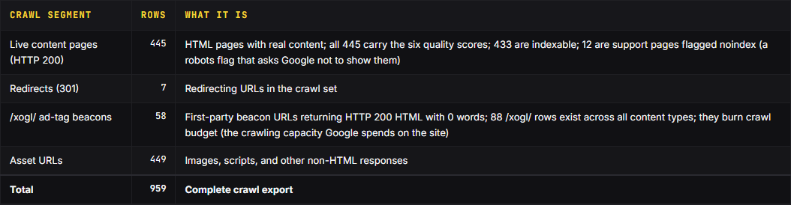
/winston
// 04 · the crawl
The crawl: 2026-09-13.
The crawl captured the live site on 2026-09-13. All 445 live pages carry the six quality scores; 433 are indexable.
No 404s and no 5xx in the crawled set. Five security headers are absent on 952 of 959 rows.
e-ita.org · recovery audit · september 2026
17

Slide 18
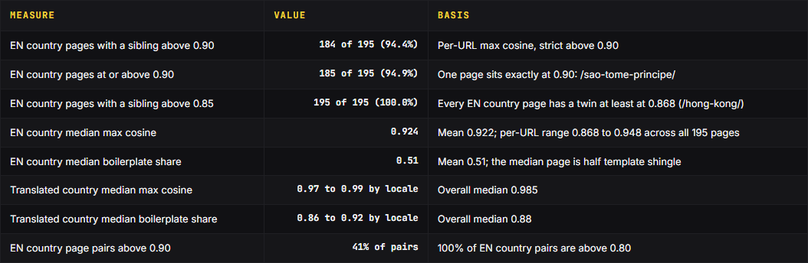
/winston
// 04 · similarity
How similar the pages really are.
184 of 195 English country pages have a sibling above 0.90 cosine similarity. Every EN country page has a twin at least at 0.868.
The median page is half template. The class is the same page with the country name swapped.
e-ita.org · recovery audit · september 2026
18

Slide 19
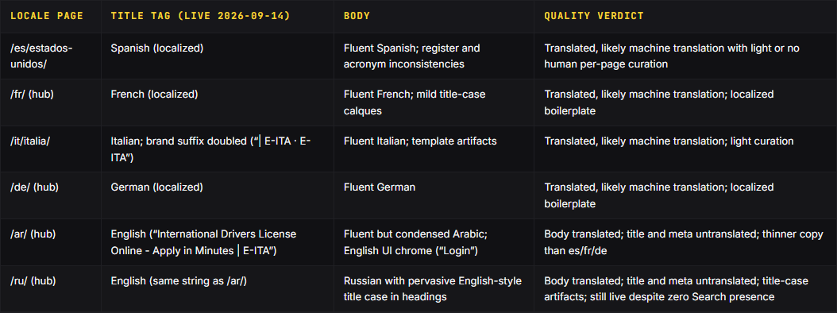
/winston
// 04 · translation
How the translations hold up.
Bodies are translated and fluent. The defects sit in the metadata layer: 8 of 11 locale hubs carry the English title tag, 7 also the English meta description.
Template artifacts no human review would leave: doubled brand suffixes and no H1 on any sampled locale FAQ page.
e-ita.org · recovery audit · september 2026
19

Slide 20
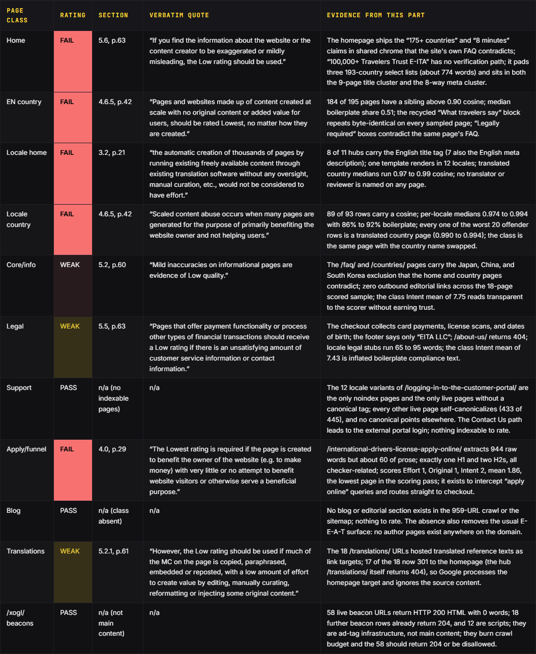
/winston
// 04 · rater guidelines
Where each class stands against the rubric.
Every class is rated FAIL, WEAK, or PASS against the Search Quality Rater Guidelines; FAIL means the class trips a Lowest or Low trigger. These are analyst reads of how the guidelines classify the pages, not Google scores.
The homepage and every hub are built to move visitors toward one checkout.
e-ita.org · recovery audit · september 2026
20

Slide 21
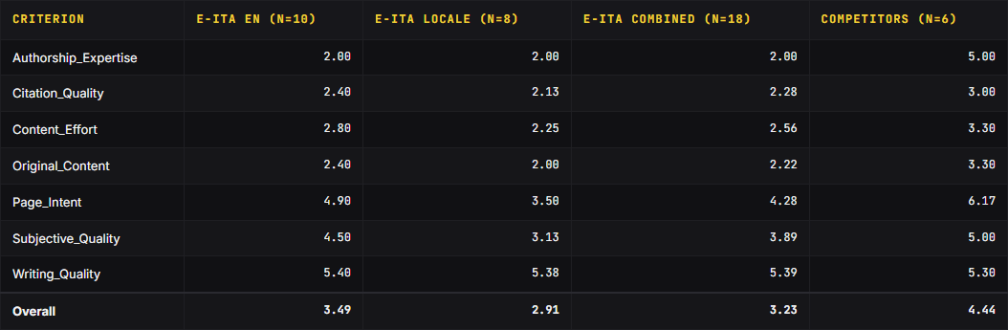
/winston
// 04 · e-e-a-t
The E-E-A-T composite.
Composite E-E-A-T: e-ita.org scores 3.23 of 10 against a private-vendor bar of 3.94 and the official issuer at 7.00.
Authorship and expertise are the weakest criteria. No page names an author.
e-ita.org · recovery audit · september 2026
21

Slide 22
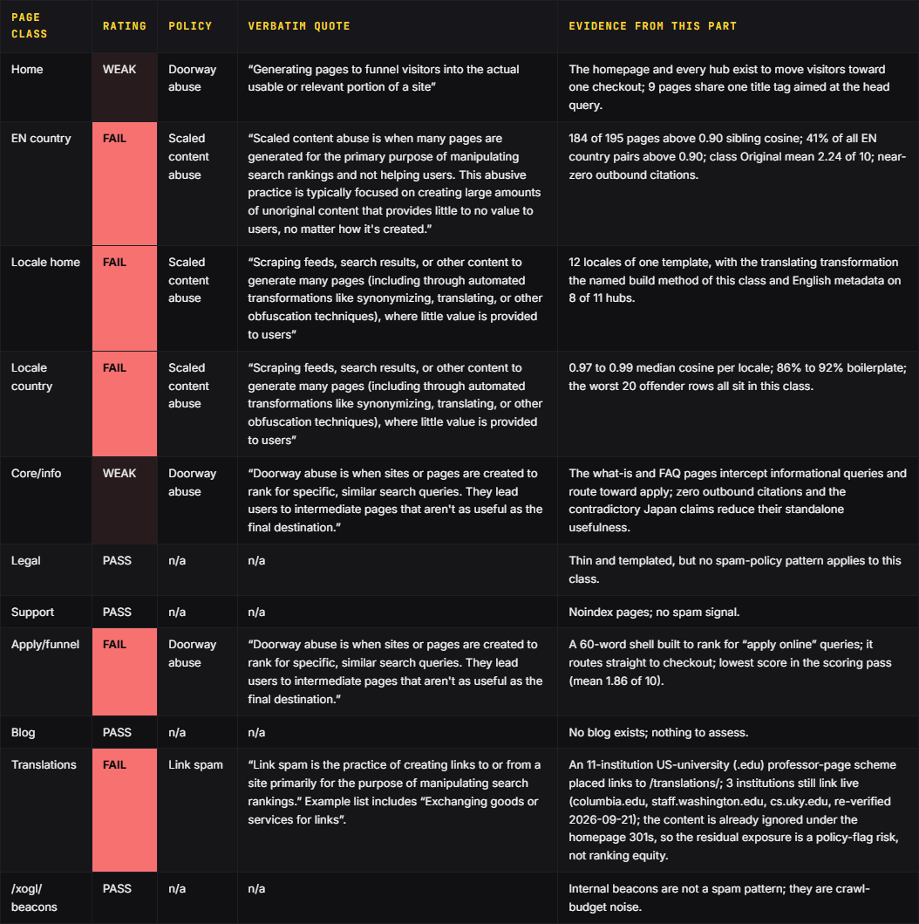
/winston
// 05 · spam policies
The spam-policy exposure.
The spam policies name this pattern: scaled content abuse, 'no matter how it's created'.
Every FAIL is class-wide. Individual exceptions do not rescue a class.
e-ita.org · recovery audit · september 2026
22

Slide 23
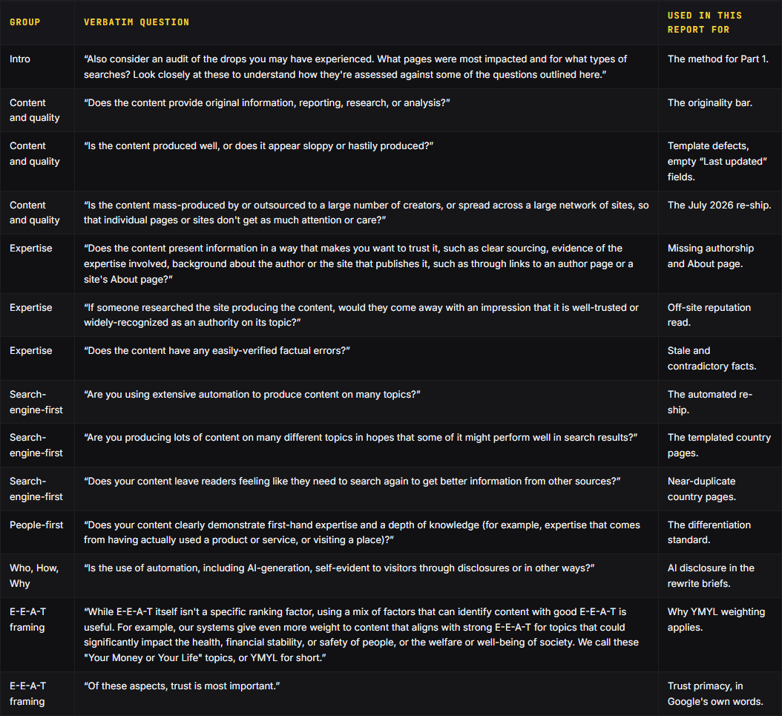
/winston
// 05 · self-assessment
The helpful-content self-assessment.
Answered for the site: the country and locale classes FAIL the mass-production and extensive-automation questions.
The expertise questions ask who wrote the content and how it was produced. No page names an author.
e-ita.org · recovery audit · september 2026
23

Slide 24
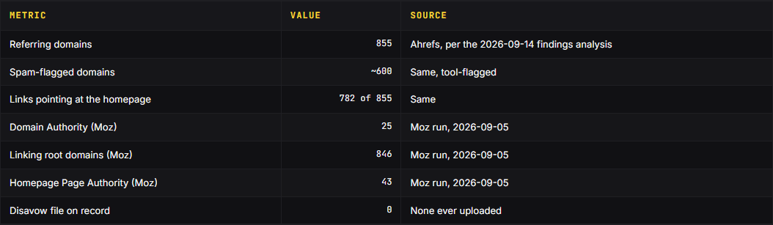
/winston
// 06 · link profile
The link profile.
About 600 of 855 referring domains are spam-flagged, and 782 of 855 point at the homepage. No disavow file is on record.
Steady directory and backlink-agency spam has arrived since November 2025.
e-ita.org · recovery audit · september 2026
24

Slide 25
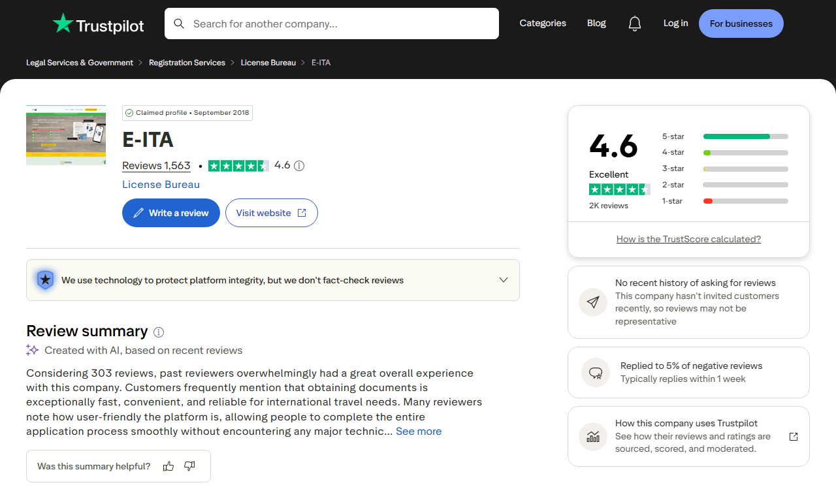
/winston
// 06 · brand sentiment
What anyone who checks will find.
Trustpilot reads 4.6 stars (2026-09-22), but about 11% of reviews are 1-star and the site replies to about 5% of negatives. The category leader replies to nearly all.
All four tested AI engines advised against using the site, anchored on the official alert, the forum threads, and the site's own claims.
e-ita.org · recovery audit · september 2026
25

Slide 26
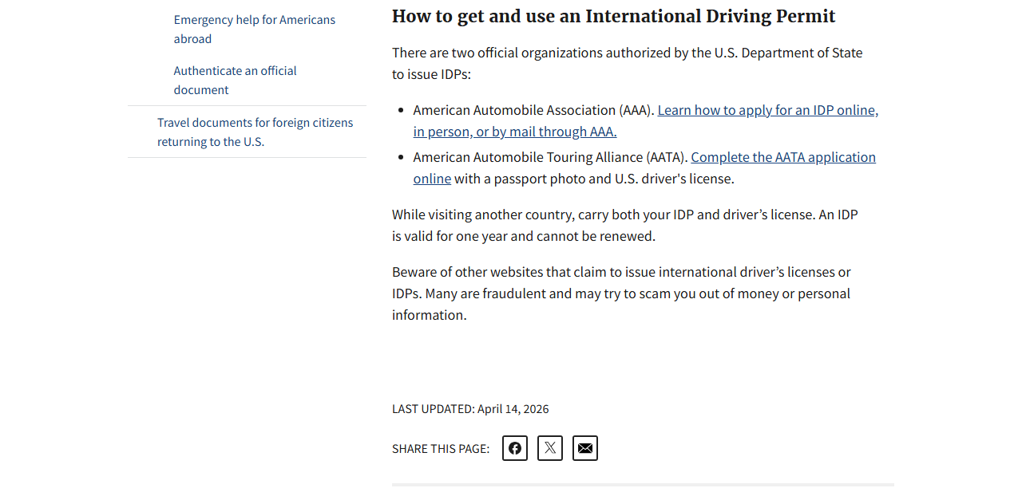
/winston
// 06 · the official frame
The official frame is narrower.
The US government authorizes exactly two IDP issuers: AAA and AATA. The official count is 'more than 150 countries'.
The site's '175+ including Japan' fails against the government's record and against the site's own FAQ.
e-ita.org · recovery audit · september 2026
26

Slide 27
/winston
// 07 · ranked causes
What caused it, in order of confidence.
Rank 1, confirmed: site-level spam demotion at the August 2026 spam update.
Rank 2, probable: scaled content abuse from the July re-ship. Rank 3, confirmed: thin E-E-A-T and a hostile reputation.
Rank 4, probable: alias domains. Rank 5, probable: link spam, ruled out for this update.
e-ita.org · recovery audit · september 2026
27

Slide 28
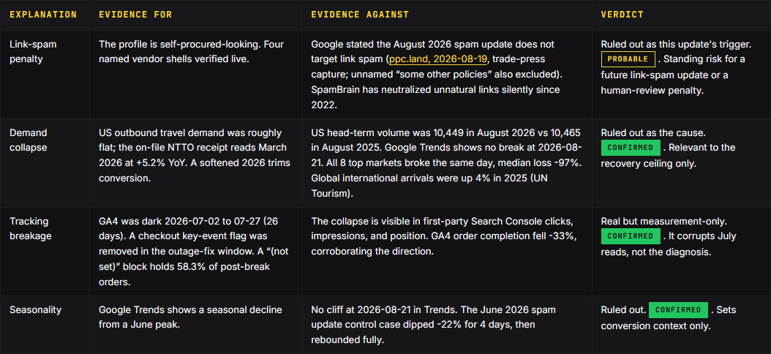
/winston
// 07 · alternatives
What else was tested.
Four alternative explanations were tested against the evidence: a link-spam penalty, a demand collapse, tracking breakage, and seasonality.
Two ruled out, one ruled out as this update’s trigger, one real but measurement-only.
e-ita.org · recovery audit · september 2026
28

Slide 29
/winston
// 08 · pages in scope
Every URL gets a verdict.
73
keep
64
rewrite
155
fold
162
kill
454 audited URLs, four buckets, one of them gets rewritten.
Every URL in both artifacts was live-verified 2026-09-21. Planned action is the deploy plan, not the current state.
e-ita.org · recovery audit · september 2026
29

Slide 30
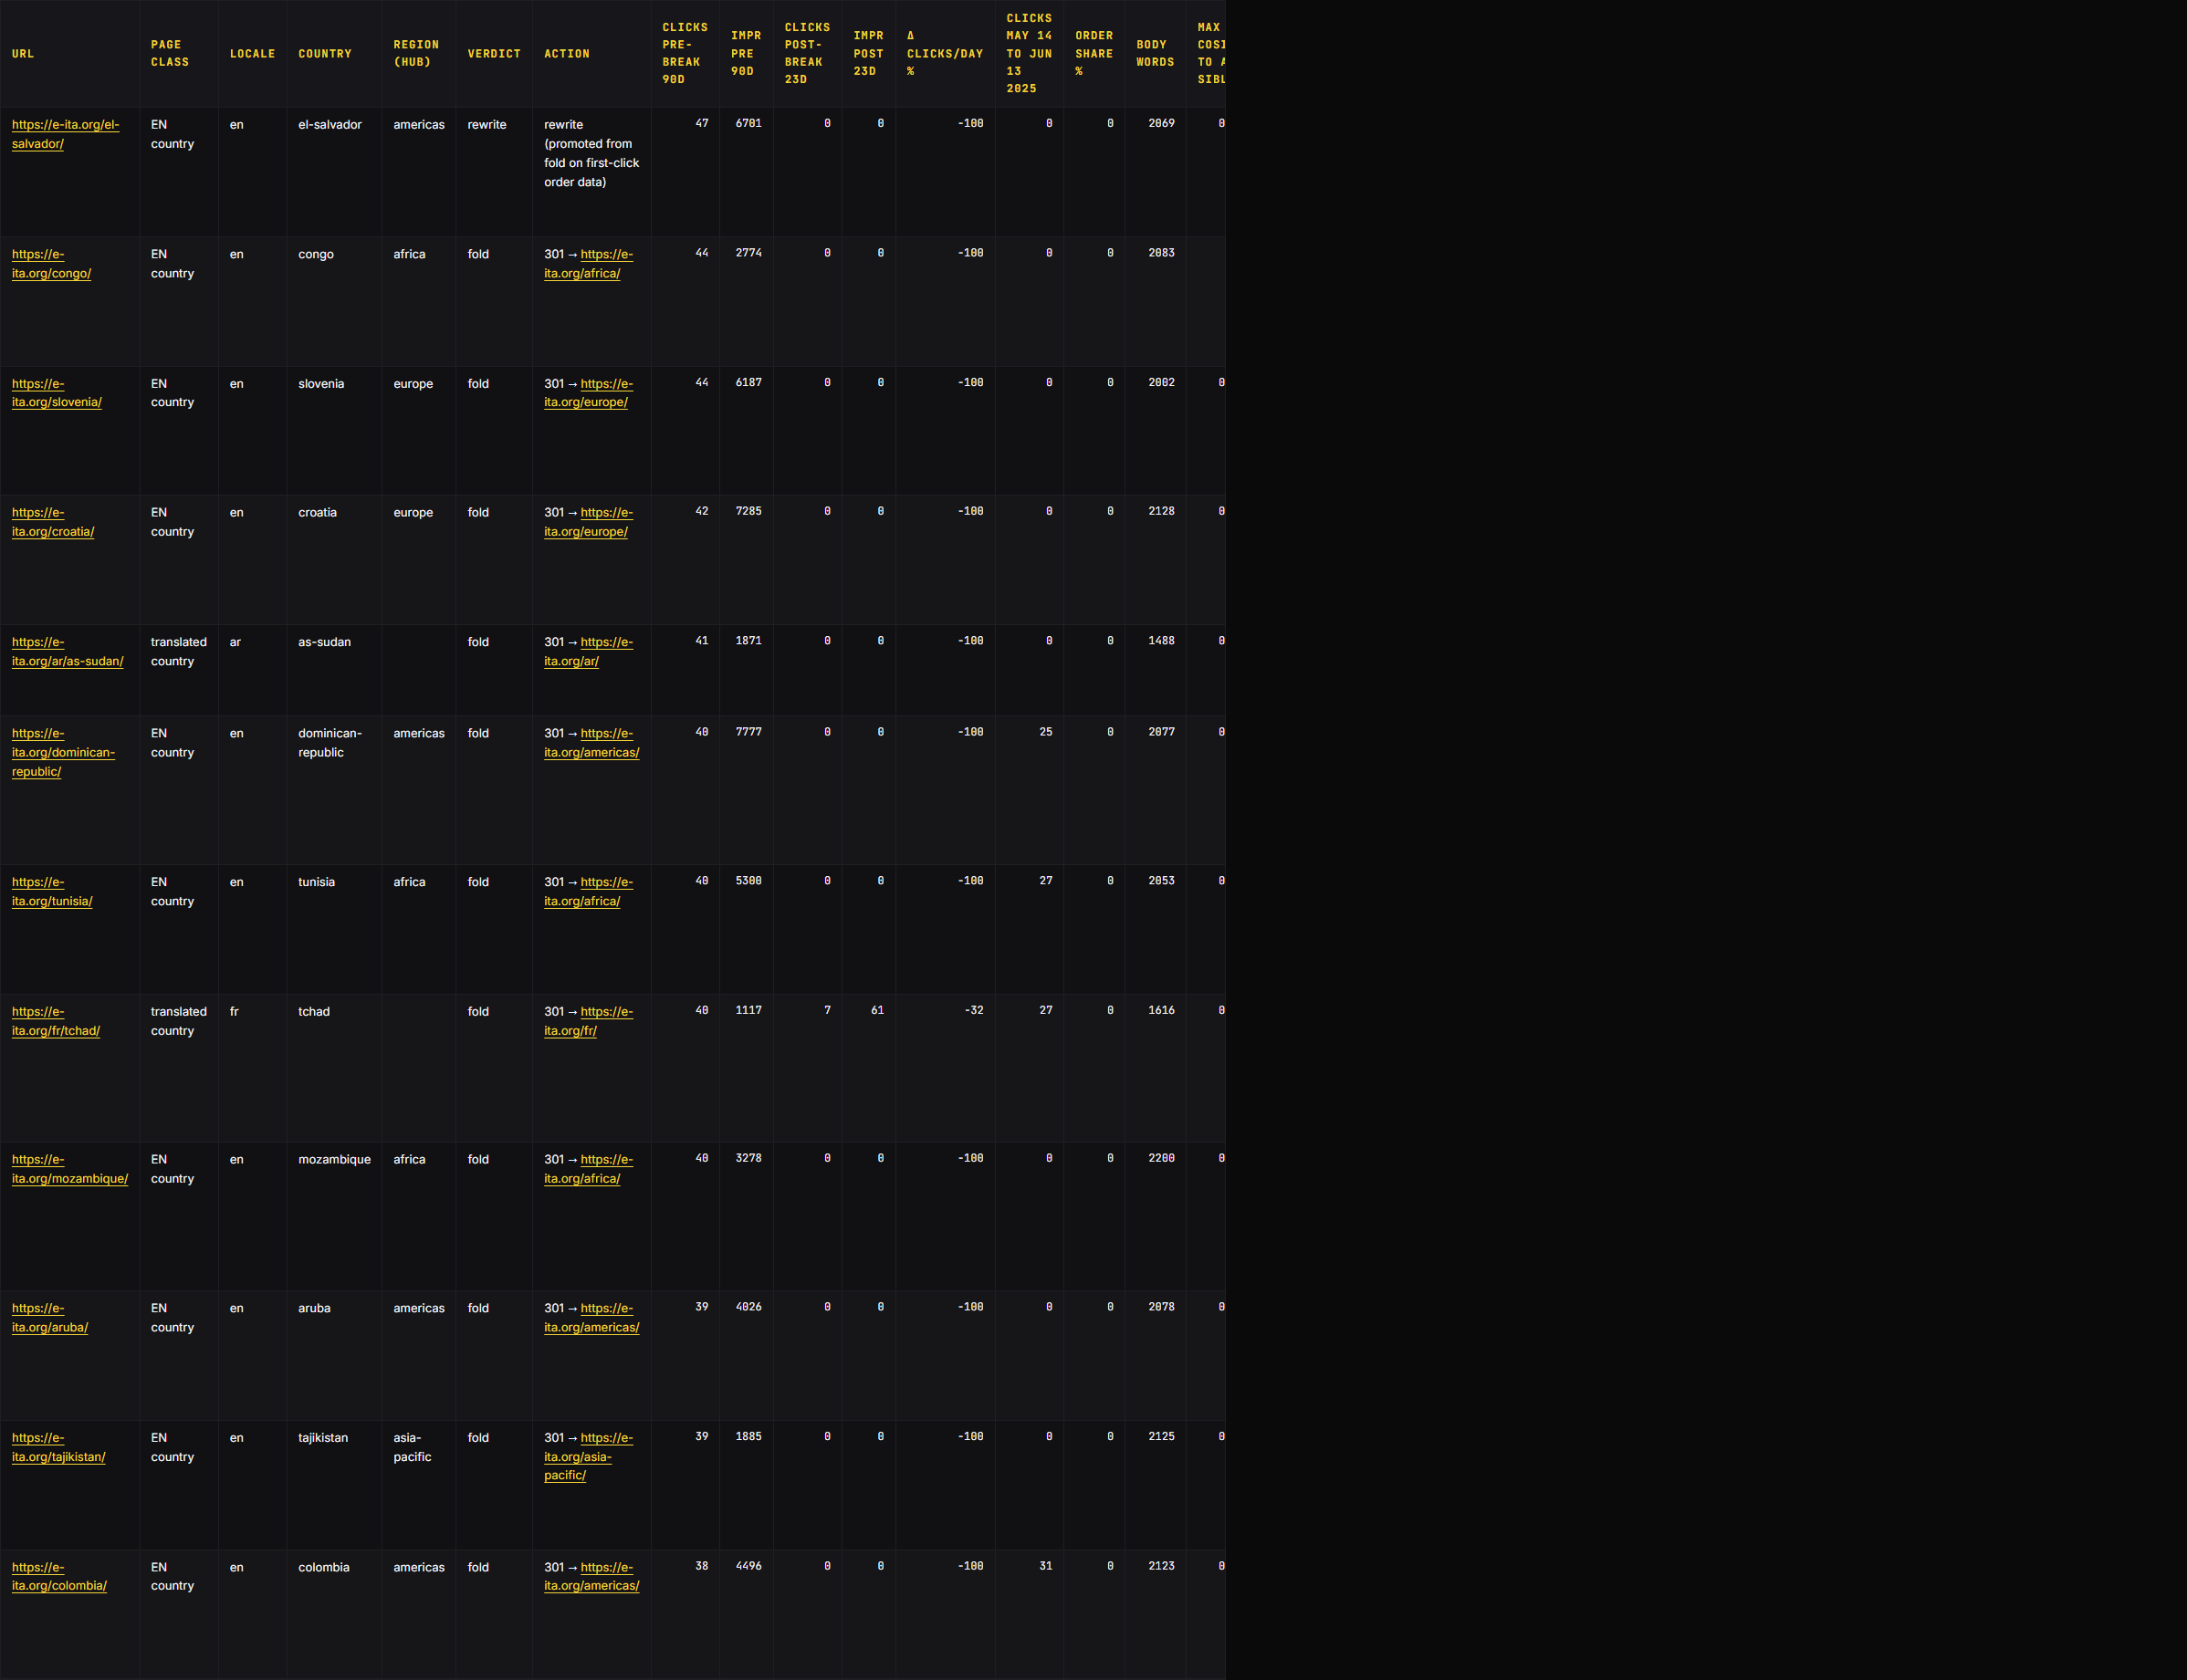
/winston
// 08 · the verdict sheet
Keep, rewrite, fold, or kill.
The full sheet classes all 454 URLs with page class, verdict, action, and the pre-break and post-break click record.
The excerpt is the top of the sheet ranked by pre-break clicks.
e-ita.org · recovery audit · september 2026
30

Slide 31
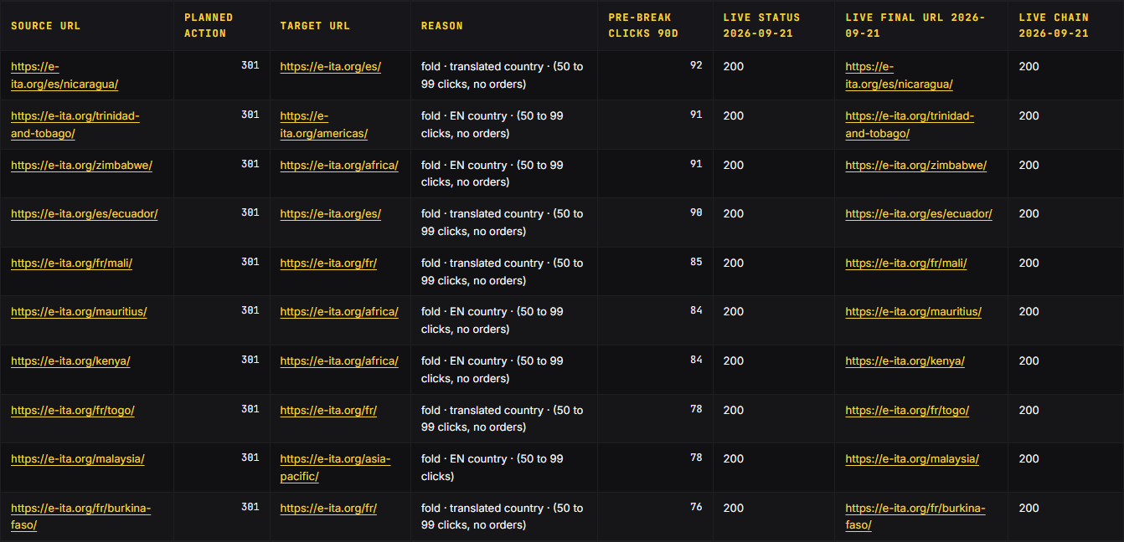
/winston
// 08 · the redirect map
Where the folded pages go.
The redirect map holds 357 rows: 177 redirects returning 301 and 180 removals returning 410.
The 177 redirects ship now. The 180 removals ship after the identity layer is live.
e-ita.org · recovery audit · september 2026
31

Slide 32
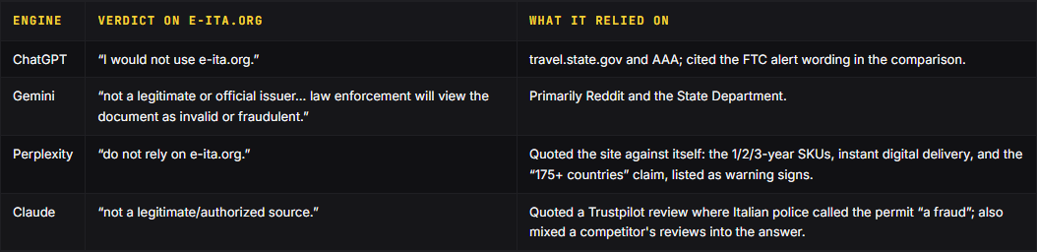
/winston
// 09 · ai-search
AI-search standing.
All four tested engines advised against the site on 2026-09-05, anchored on the FTC alert, the forum threads, and the site's own claims.
On 'best online IDP 2026', every engine names AAA as the only fully legitimate option.
e-ita.org · recovery audit · september 2026
32

Slide 33
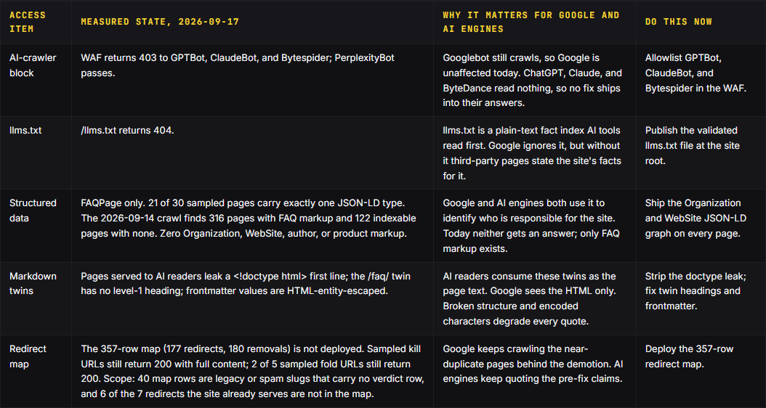
/winston
// 09 · access layer
The crawler and access layer.
The site-state snapshot on 2026-09-17: AI crawlers blocked, no llms.txt, and structured data limited to FAQ markup.
Access is the gate for everything in the recovery plan.
e-ita.org · recovery audit · september 2026
33

Slide 34
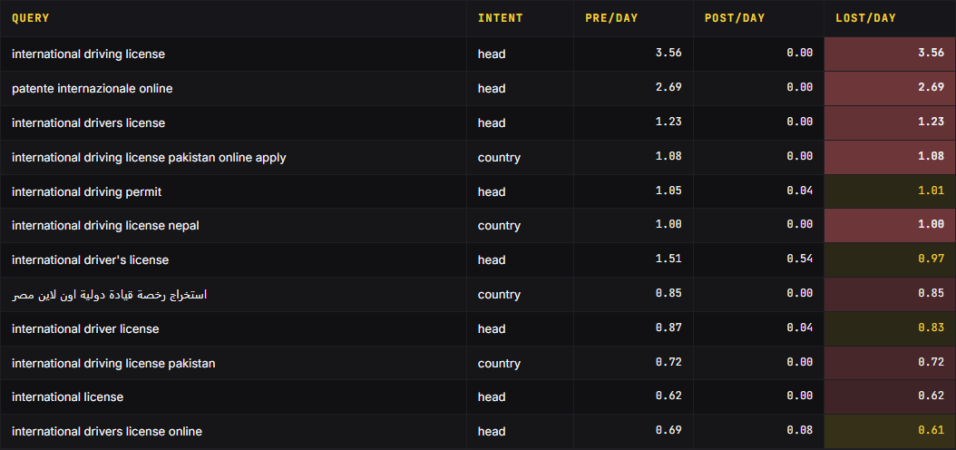
/winston
// 09 · demand
Where the lost demand sits.
The demand map ranks what was lost, by query, by intent, and by destination country.
Query exports cover the identifiable slice: 94.9 of 275.5 pre-break daily clicks, and 15.4 of 30.9 post-break.
e-ita.org · recovery audit · september 2026
34

Slide 35
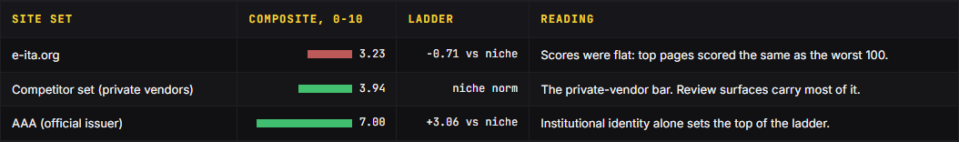
/winston
// 09 · trust ladder
The category ceiling is trust.
The trust ladder: e-ita.org at 3.23, the private-vendor bar at 3.94, and the official issuer at 7.00.
Even the strongest private vendor trails the official issuer by 2.00 points. Trust sets the category ceiling.
e-ita.org · recovery audit · september 2026
35

Slide 36
/winston
// 09 · measurement integrity
What the analytics can prove.
Conversion tracking cannot currently certify the size of the business loss. Three gaps block it, including the July GA4 hole.
Any dollarized loss claim is unverifiable today. Clean instrumentation is a precondition for the re-measure.
e-ita.org · recovery audit · september 2026
36

Slide 37
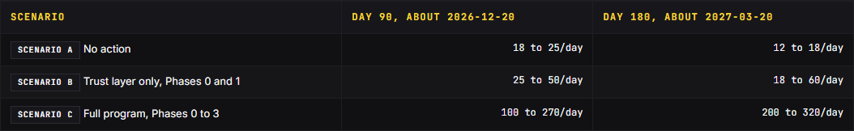
/winston
// 09 · scenarios
What recovery can look like.
Three scenarios, read at day 90 and day 180: a no-action path, a partial path, and the full-program path.
These are planning ranges, not promises. The measured target sits in the Part 7 framework.
e-ita.org · recovery audit · september 2026
37

Slide 38
/winston
// 10 · why not roll back
Why not roll back.
Should the site roll back to an earlier state? No. Archive checks show every earlier version carried the same template and claims layer that lost traffic.
Rollback is cleanup, not recovery. Reverting cannot show what Google re-scored in August 2026.
e-ita.org · recovery audit · september 2026
38

Slide 39
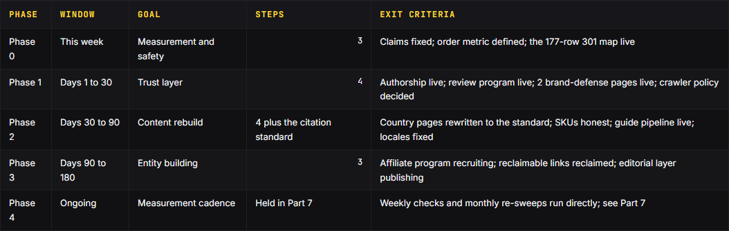
/winston
// 10 · the phases
Five phases, sequenced.
Five phases in order: measurement and safety, the trust layer, the content rebuild, entity building, then the measurement cadence.
14 steps, each with an acceptance check. The redirect map ships in two stages. Part 6 of the report is the full implementation guide.
e-ita.org · recovery audit · september 2026
39

Slide 40
/winston
// 10 · phases 0 and 1
This week, then the trust layer.
Phase 0, this week: remove the contradicting claims, define the order metric, and deploy the redirect map.
Phase 1, days 1 to 30: named authorship live, the review program live, two brand-defense pages live, and the AI-crawler policy set.
e-ita.org · recovery audit · september 2026
40

Slide 41
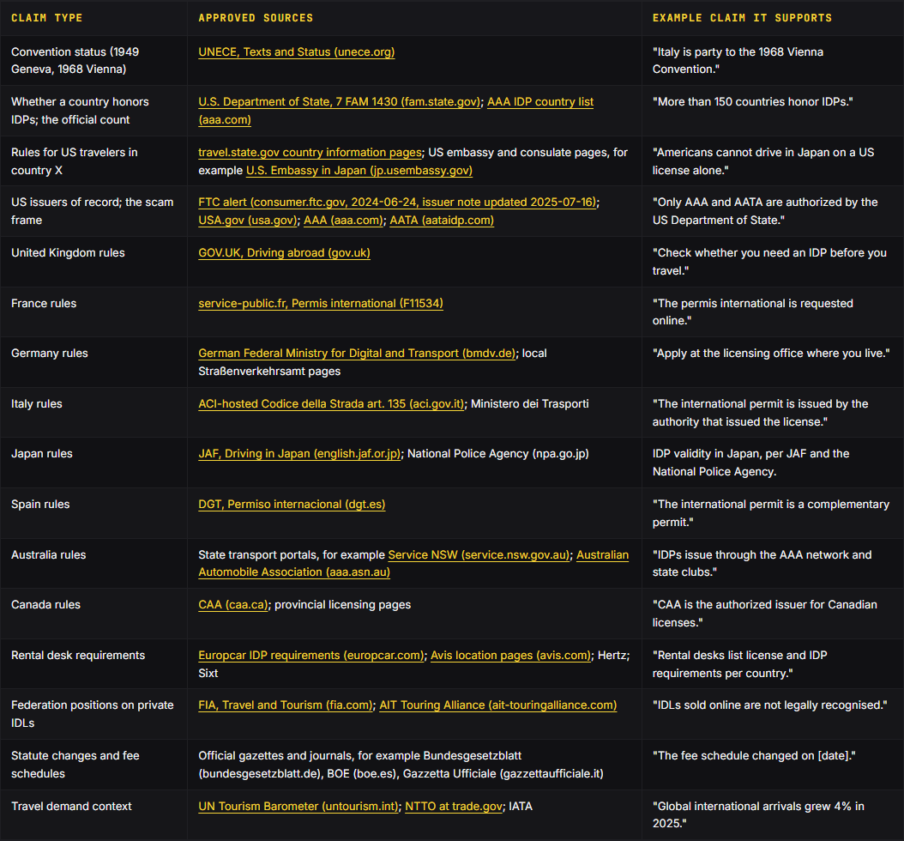
/winston
// 10 · phase 2
The content rebuild.
Phase 2, days 30 to 90: the 64 rewrite-verdict pages rewritten to the Differentiation Standard, renewal plans in place of multi-year SKUs, and the country-guide pipeline.
The citation standard governs every page: a whitelist of approved sources and the claims that cannot ship.
Every Google citation in the report is carried verbatim in the appendix. The Google API leak attributes appear as corroborating context only, never as primary evidence.
e-ita.org · recovery audit · september 2026
41

Slide 42
/winston
// 10 · phases 3 and 4
Entity building, then measurement.
Phase 3, days 90 to 180: the affiliate program recruiting, reclaimable links reclaimed, and the editorial layer built.
Phase 4, ongoing: the measurement cadence, weekly checks and monthly re-sweeps against the Part 7 gates.
e-ita.org · recovery audit · september 2026
42

Slide 43
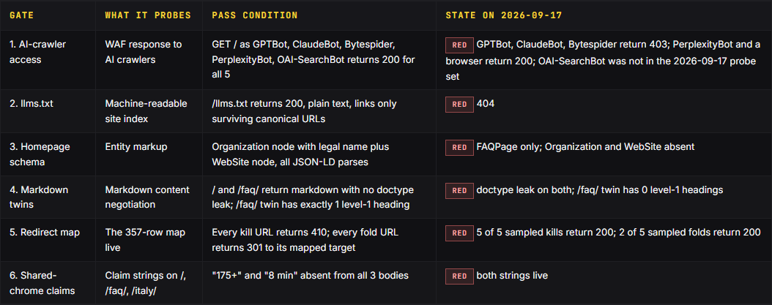
/winston
// 11 · readiness gates
Zero of six gates are green.
0 of 6 readiness gates are green, probed 2026-09-17: AI crawlers blocked, llms.txt missing, the claims live, and the redirect map undeployed.
Every threshold was fixed on 2026-09-17, before any recovery data existed. They do not move after the fact.
e-ita.org · recovery audit · september 2026
43

Slide 44
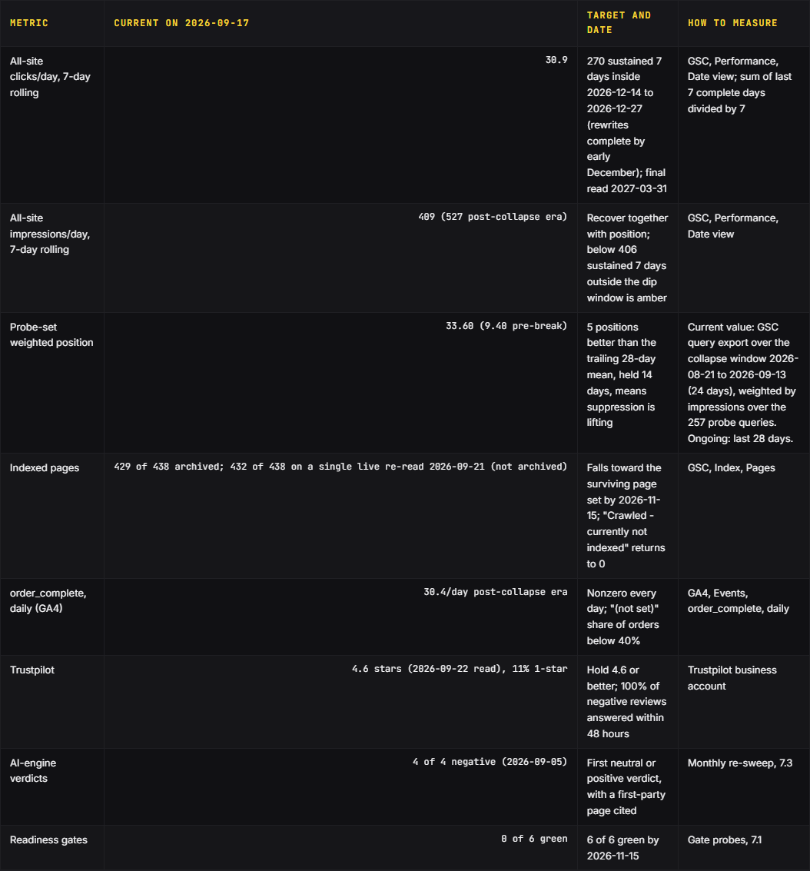
/winston
// 11 · scorecard
The scorecard and decision rules.
The scorecard holds each metric with its current value, its target, and its measurement method.
Recovery is declared by data, not by effort: the decision rules define the lift and pivot reads.
e-ita.org · recovery audit · september 2026
44

Slide 45
/winston
// next steps
Start this week.
Remove the contradicting claims in one template deploy, freeze the page set, and deploy the 177-row redirect map.
Then the trust layer, the content rebuild, and entity building run in sequence against the six readiness gates.
> /winston recover --site=e-ita.org --start=this-week
e-ita.org · recovery audit · september 2026
45

