Slide 1
/winston
// travel-content-skill · walkthrough
The content skill, in action.
What the skill linked in the recovery plan does, end to end: one live run, every step, shown as it happened.
SKILL
RUN
STEPS
OUTPUT
travel-content-skill
2026-09-24
5 + 2 checkpoints
3 pages + 3 locales
travel-content-skill · walkthrough · september 2026
01

Slide 2
/winston
// the shape of a run
The skill at a glance.
Step 1 researches the topic universe and writes a claim ledger: every fact dated, tiered, and sourced.
Step 2 scores the research into a ranked idea slate. Checkpoint 1: the operator keeps, re-researches, or reselects.
Step 3 drafts the kept ideas. Step 4 edits each draft. Step 5 audits each draft against live sources and fixes what fails.
Checkpoint 2: the operator reviews and picks translations. Step 6 translates with a shared termbase.
travel-content-skill · walkthrough · september 2026
02

Slide 3
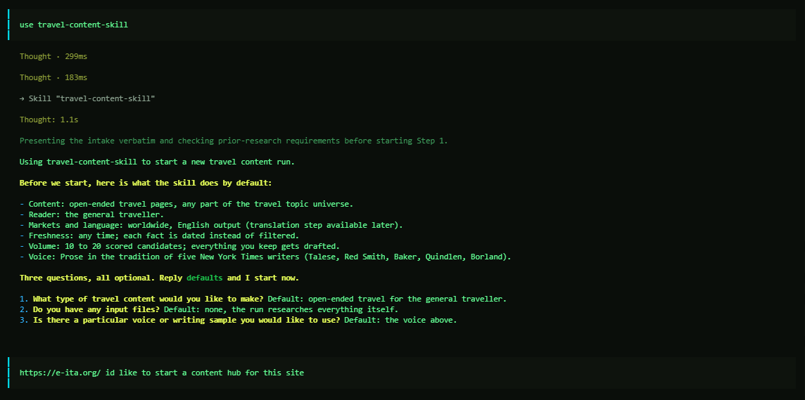
/winston
// intake
Invoke the skill.
One command starts the run. The skill answers with its defaults: content type, reader, markets, freshness, volume, and voice.
Three questions, all optional. The operator names the site and the job: a content hub for e-ita.org.
travel-content-skill · walkthrough · september 2026
03

Slide 4
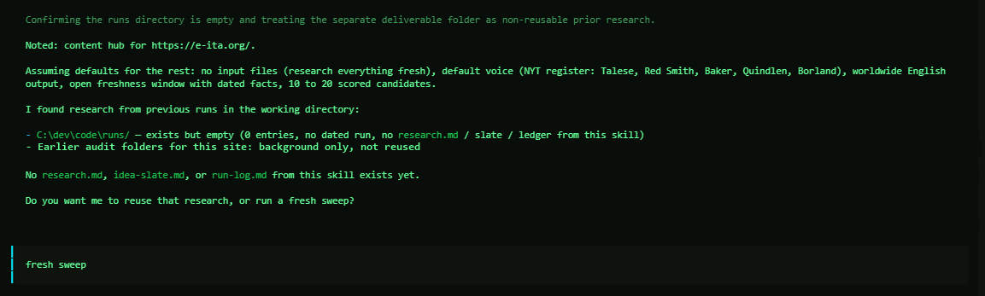
/winston
// intake
Reuse or start fresh.
The skill checks the working directory for prior research and asks before reusing any of it.
This run: a fresh sweep. Nothing stale carries in.
travel-content-skill · walkthrough · september 2026
04

Slide 5
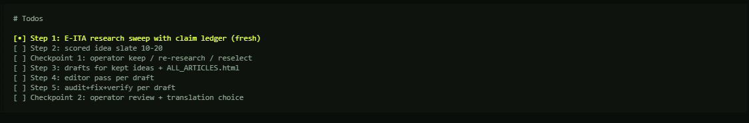
/winston
// the plan
The run is a checklist.
Five core steps and two operator checkpoints, tracked from the start. Translation (step 6) runs only on request.
Nothing advances without its box checked.
travel-content-skill · walkthrough · september 2026
05

Slide 6
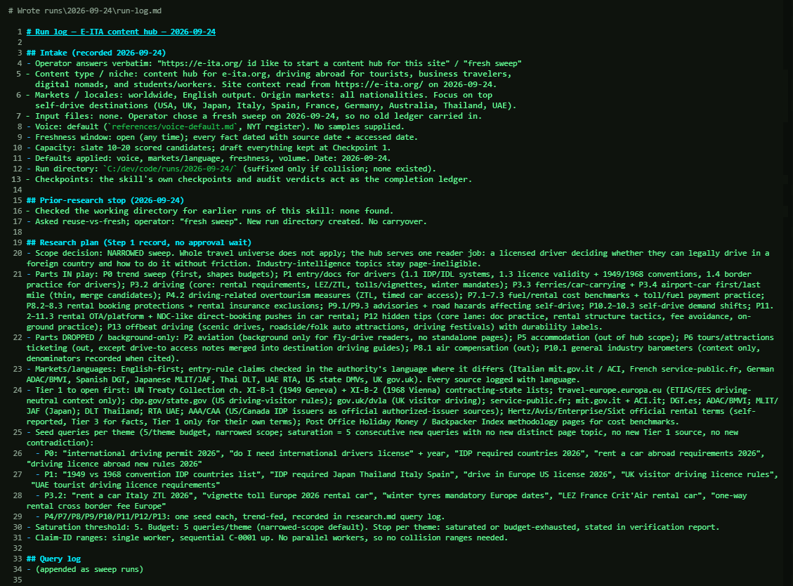
/winston
// step 1 · research
The sweep is planned before it runs.
Every intake answer lands in the run log first. Then the plan: scope, source tiers, seed queries, and the saturation rule that tells the sweep when to stop.
travel-content-skill · walkthrough · september 2026
06

Slide 7
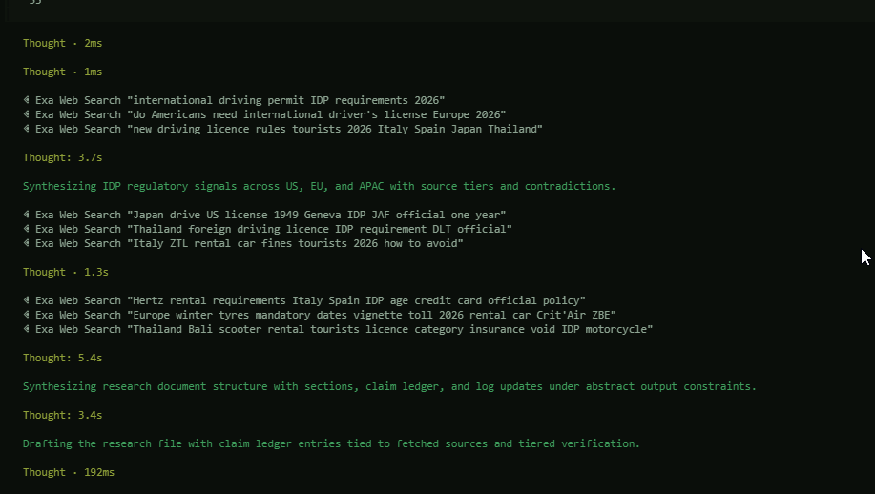
/winston
// step 1 · research
The sweep runs live.
Searches fan out across the topic universe: US, EU, and APAC rules, rental-desk terms, border practice.
Every result is tiered by authority as it lands.
travel-content-skill · walkthrough · september 2026
07

Slide 8
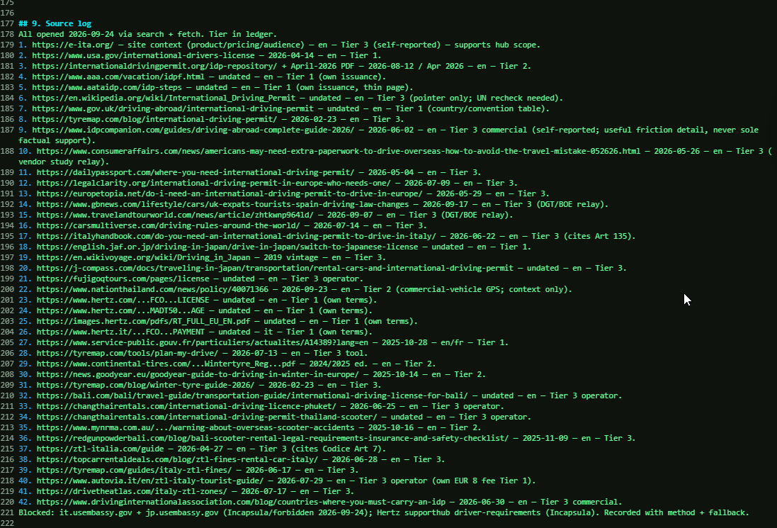
/winston
// step 1 · research
Every source is logged and tiered.
The source log records each URL with its date, language, and tier.
Tier 1 is official issuer and government text. Lower tiers are marked as what they are, never silently trusted.
travel-content-skill · walkthrough · september 2026
08

Slide 9
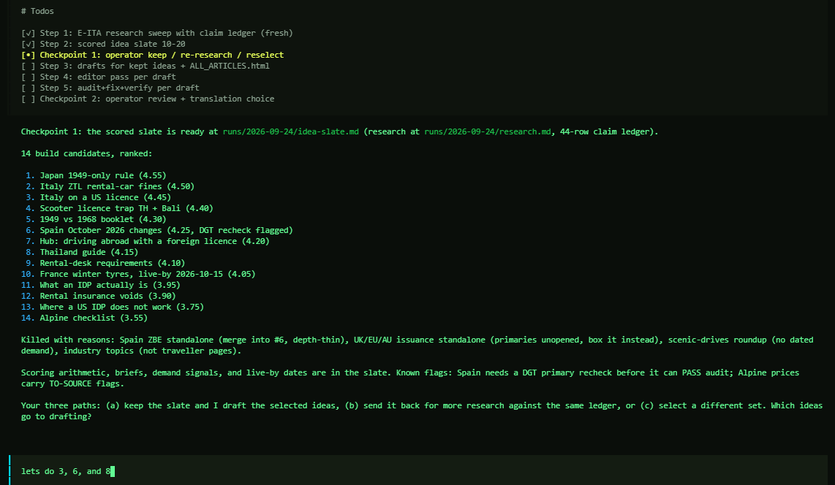
/winston
// checkpoint 1
Research becomes a scored slate.
Fourteen candidate pages, ranked, each with a score and a brief. Weak ideas are killed with reasons, in writing.
The operator picks what gets drafted: 3, 6, and 8.
travel-content-skill · walkthrough · september 2026
09

Slide 10
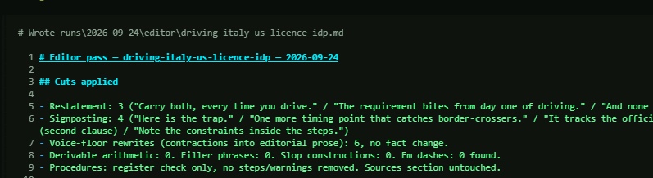
/winston
// step 4 · editor
The editor pass.
Each draft is cut and tightened, with a written record of every change: restatements, signposting, filler.
Voice rewrites never touch a fact. Zero em dashes, verified.
travel-content-skill · walkthrough · september 2026
10

Slide 11
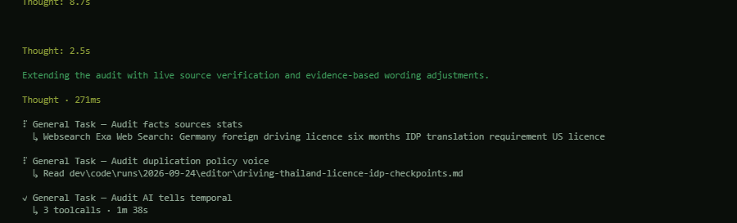
/winston
// step 5 · audit
The audit pass.
Every drafted page is audited in parallel: facts against live sources, duplication and policy, AI-writing tells.
An error the audit catches gets fixed before the page can pass.
travel-content-skill · walkthrough · september 2026
11

Slide 12
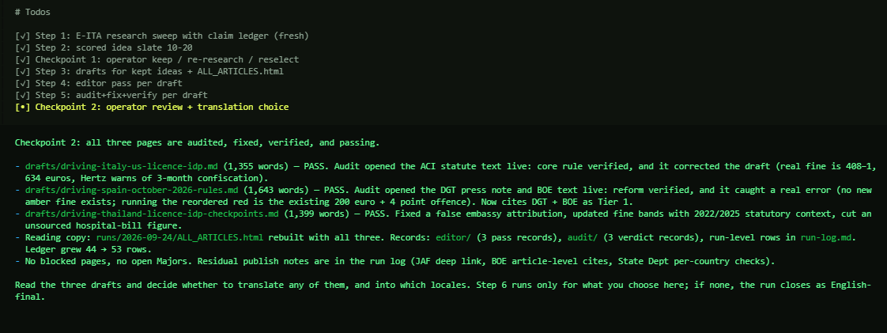
/winston
// checkpoint 2
Pass, or fix and re-audit.
All three pages pass with their audit notes attached: what was verified, what was corrected, what changed. E-ITA adds the author and reviewer names before publishing.
The operator decides what translates, and into which locales.
travel-content-skill · walkthrough · september 2026
12

Slide 13
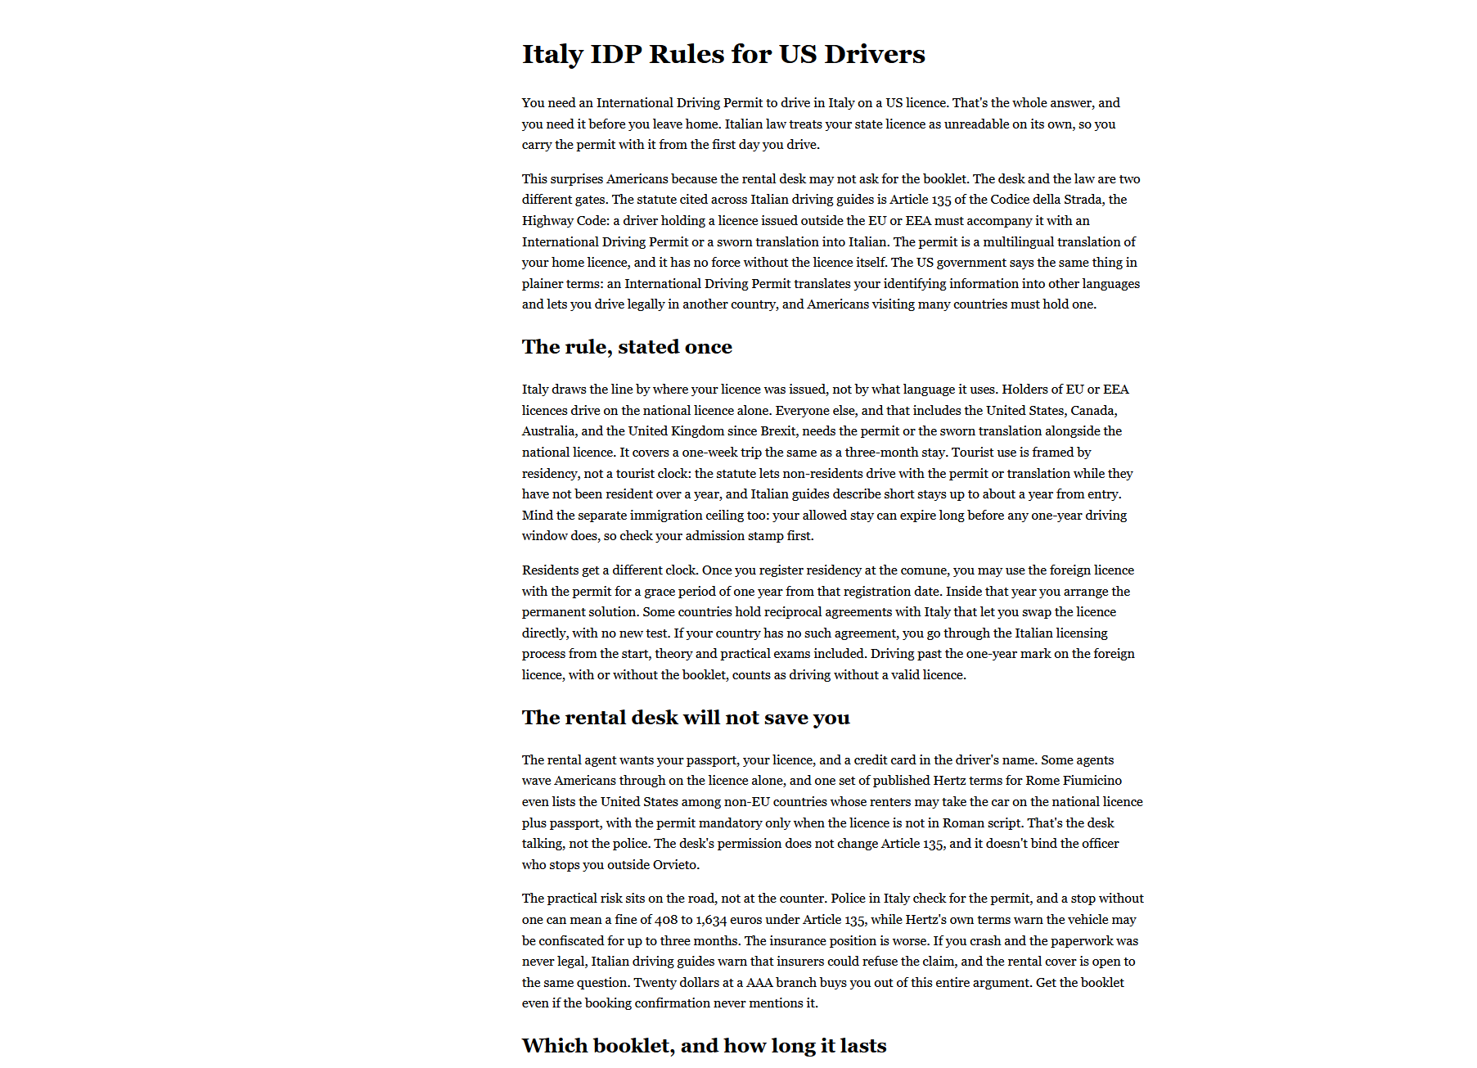
/winston
// the output
The output is the article.
A finished page in ALL_ARTICLES.html: the answer in the first paragraph, sourced prose after it, no padding.
This is the page the skill exists to write.
travel-content-skill · walkthrough · september 2026
13

Slide 14
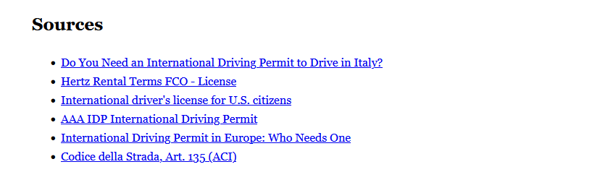
/winston
// the output
Every article ends in its sources.
The citation list is part of the deliverable, not an afterthought.
Each claim in the page traces to one of these. On e-ita.org, every source line carries an accessed date in YYYY-MM-DD form (Recovery Plan, citation mechanics).
travel-content-skill · walkthrough · september 2026
14

Slide 15
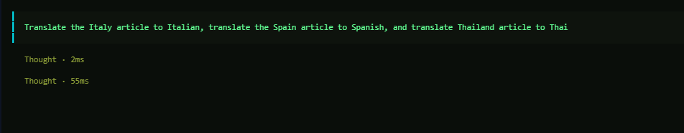
/winston
// step 6 · translation
Translation runs on request.
One instruction covers all three: Italy to Italian, Spain to Spanish, Thailand to Thai. On e-ita.org, only the 4 locales the verdict sheet keeps (es, fr, it, ar) get translated pages.
Official names stay untranslated. Formats, dates, and procedures localize.
travel-content-skill · walkthrough · september 2026
15

Slide 16
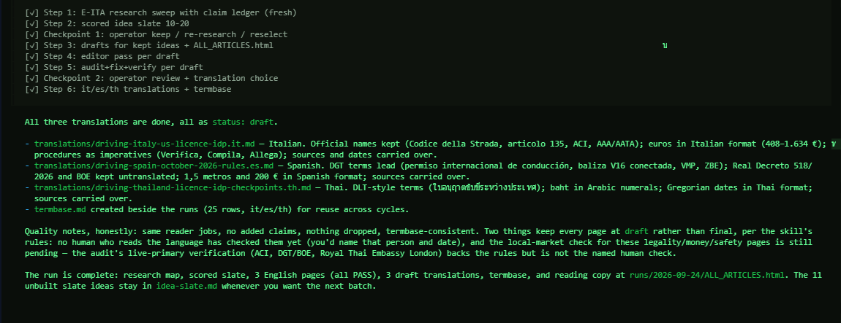
/winston
// run complete
The run closes with a ledger.
Three English pages, all passing. Three draft translations with a shared termbase, marked draft until a native speaker checks them.
The unbuilt slate ideas stay queued for the next batch.
travel-content-skill · walkthrough · september 2026
16

Slide 17
/winston
// next run
Run it again next month.
The slate, the ledger, and the termbase carry over. The next run starts from last month's work, not from zero.
Cadence: run this as a repeatable monthly cycle, not a one-off project. The cycle is research, a scored list of ideas, drafting, an editor pass, an audit and fix pass, and localization where needed. Every page needs a named author and a named reviewer, as in Phase 1, step 1. A page ships only when a reader cannot get the same thing elsewhere.
travel-content-skill · walkthrough · september 2026
17

