Slide 1
/winston
// algorithm drop analysis
E-ITA recovery audit.
The evidence base on the 2026-08-21 collapse: what was lost, what caused it, and how each candidate cause was confirmed, downgraded, or ruled out.
SITE
WINDOW
REPORT DATE
BREAK DATE
e-ita.org
2025-05-02 to 2026-09-16
2026-09-24
2026-08-21

Slide 2
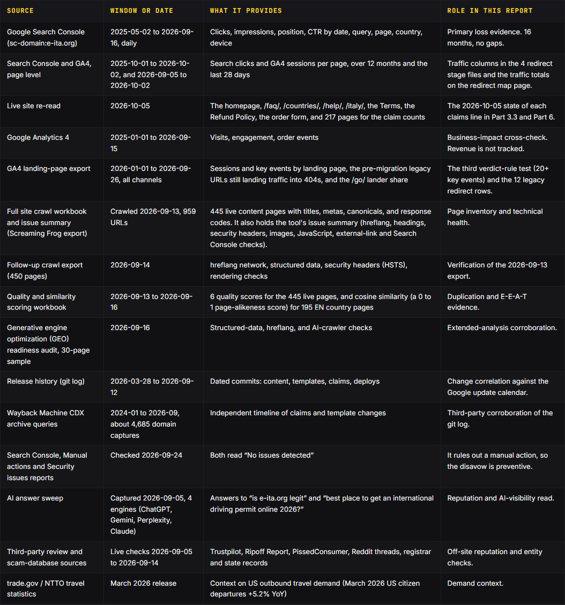
/winston
// how this audit was done
Methodology and data sources.
Every number in this report traces to one of the sources. First-party data wins over third-party estimates.
Source: the site release history (git log, 2026-03-28 to 2026-09-12); the Google update calendar; Google Search Console, 2025-05-02 to 2026-09-16.
Every class is rated against the Search Quality Rater Guidelines, the helpful content self-assessment, and the spam policies. The ratings are analyst reads of how the guidelines classify the pages, not Google scores.
e-ita.org · recovery audit · september 2026
02

Slide 3
/winston
// 01 · executive summary
What happened.
-88.8%
Clicks lost, plateau to post-collapse
-97.8%
Impressions lost, 24,220/day to 527/day
30.9
Post-collapse clicks/day, 2026-08-21 to 09-13
1.0 to 1.6
Brand rankings held at positions
On 2026-08-21, the final day of the August 2026 spam update, clicks fell from 205 to 39 in one day. About 255 indexable near-identical pages were re-shipped in one week, 42 to 49 days before the break.
Rank 3 is a thin trust layer on a YMYL topic, which likely caps recovery.
e-ita.org · recovery audit · september 2026
03

Slide 4
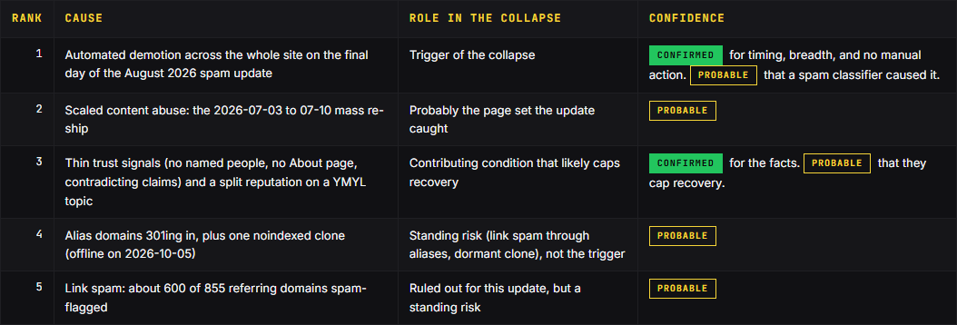
/winston
// 01 · the verdict
The verdict: ranked causes.
Rank 1, the trigger, is an automated demotion across the whole site. Its timing and breadth are confirmed. A spam classifier is the probable cause. A one-day step on 2026-08-21 hit every top market and every major content page class at once.
Rank 2 is the mass re-ship of near-identical pages from 2026-07-03 to 07-10. It is probably the page set the update caught. About 255 indexable near-identical pages were re-shipped in one week, 42 to 49 days before the break.
e-ita.org · recovery audit · september 2026
04

Slide 5
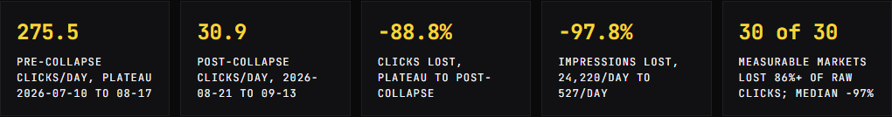
/winston
// 01 · the numbers
The numbers that matter.
In the weeks just before the drop, from 2026-07-10 to 08-17, the site averaged 275.5 clicks and 24,220 impressions a day. From 2026-08-21 to 2026-09-13 the site averaged 30.9 clicks and 527 impressions a day. August 2026 moved position 9.1 to 18.9 in a day, a demotion.
No content class held. Every content class lost 55% to 97% of daily clicks across the break. On raw P1-to-P3 totals every one of the 30 markets lost at least 86%, and the median loss is -97%.
e-ita.org · recovery audit · september 2026
05

Slide 6
/winston
// 01 · the actions
The 4 most important actions.
Freeze the page set. Publish no new country or locale page that the plan does not name, and run no bulk automated rewrites. Informational or support pages that fix messaging, such as a guarantees page, are fine. Why: the update probably caught a mass re-ship of about 255 near-identical pages (rank 2).
Ship the claims fix in one deploy. Keep a country number E-ITA can back, and drop the words 'accept', 'accepted' and 'valid'. Publish one exclusion list (Japan, South Korea, mainland China). Wherever '8 minutes' appears, add the condition from the Terms and say what the higher-fee urgent option adds. The AAA/AATA block is optional, for US-focused pages only.
Ship the redirects in stages. Only 15 ship now: the redirects whose target pages already exist. Return 410 (gone) for the 162 kill URLs after E-ITA reviews the fold and kill lists.
Show who runs the site. Name an author and a reviewer for every page. Publish an About page and a real contact page. Named people fix the first part of rank 3, thin trust signals.
The home, country, locale, and apply page classes trip a Lowest or Low trigger in the rater rubric. Composite E-E-A-T is 3.23 of 10, against 3.94 for the private-vendor set and 7.00 for the official issuer.
Part 4, entity and off-site: about 600 of 855 referring domains are spam-flagged, and 782 of 855 point at the homepage. Trustpilot reads 4.6 stars with about 11% 1-star reviews. The FTC alert and USA.gov name only AAA and AATA as authorized US issuers.
Part 5, extended analysis: all four tested AI engines advised against the site in early September. With no action, the site keeps sliding: 18 to 25 clicks/day at day 90 and 12 to 18 at day 180. The full program can reach 100 to 270/day at day 90 if Google re-scores the site by then, and 200 to 320/day at day 180. Day 90 may still show the floor.
e-ita.org · recovery audit · september 2026
06

Slide 7
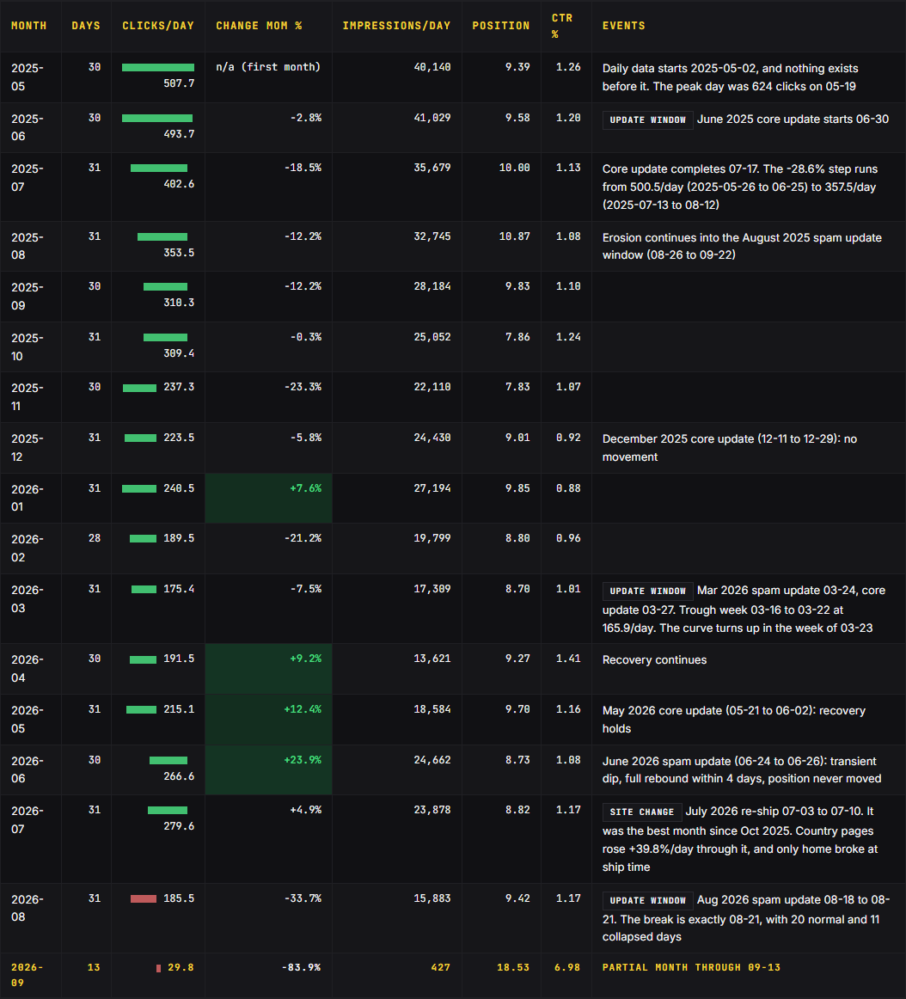
/winston
// 02 · sixteen months
The two breaks.
The first came in the June 2025 core update. Clicks stepped down 28.6%, from 500.5 a day to 357.5. The site never won that back.
The cliff landed on 08-21: clicks went from 205 to 39 (-81.0%), and impressions from 15,145 to 854 (-94.4%).
e-ita.org · recovery audit · september 2026
07

Slide 8
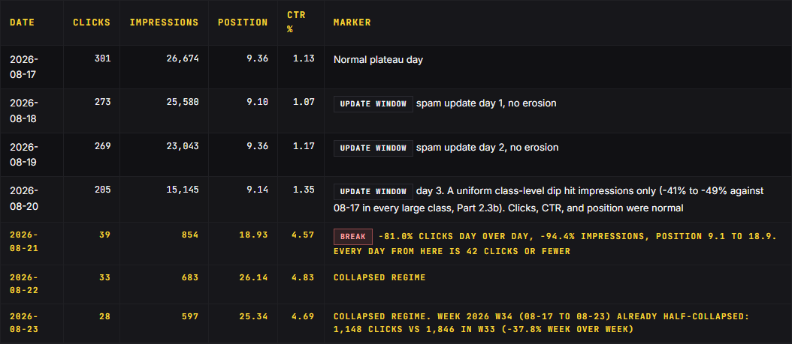
/winston
// 02 · the break day
The break is 2026-08-21.
The last day with normal clicks, CTR, and position was 2026-08-20. Impressions fell 94.4% in one day (15,145 to 854), and clicks fell 81.0% (205 to 39). The break is 2026-08-21, the largest day-over-day drop in the 503-day series.
Position worsens again the day after impressions vanish, then stays near 25 (18.93, 26.14, 25.34). The demotion deepened after the break.
e-ita.org · recovery audit · september 2026
08

Slide 9
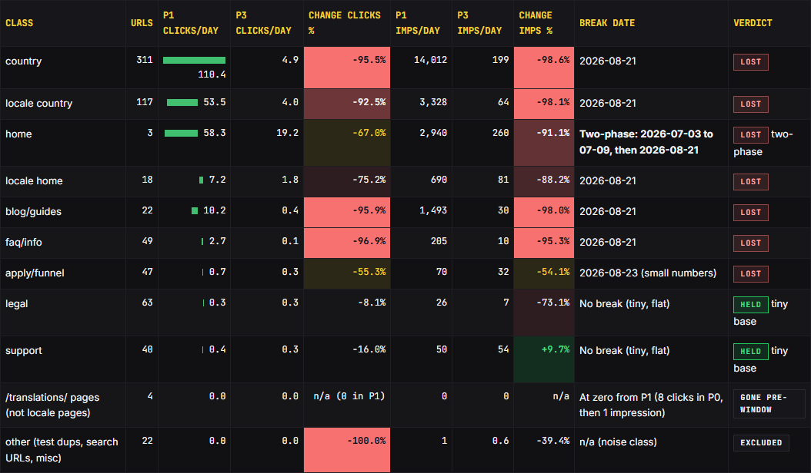
/winston
// 02 · page classes
Page classes: what lost, what held.
No content class held. Every content class fell 55% to 97% of daily clicks across the break.
Only legal and support held, on near-zero bases. The home page is the only two-phase break.
e-ita.org · recovery audit · september 2026
09

Slide 10
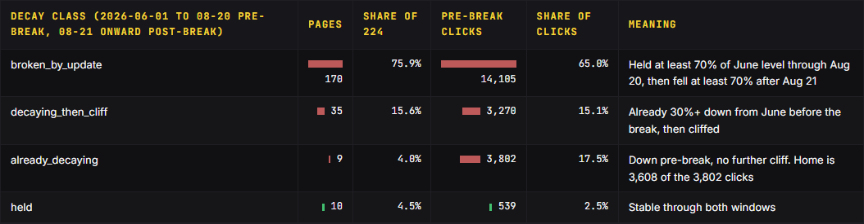
/winston
// 02 · decay split
Broken by the update, not decaying.
75.9% of measurable pages were broken purely by the update, not decaying before it.
But 44 pages carried a real pre-existing decline.
e-ita.org · recovery audit · september 2026
10

Slide 11
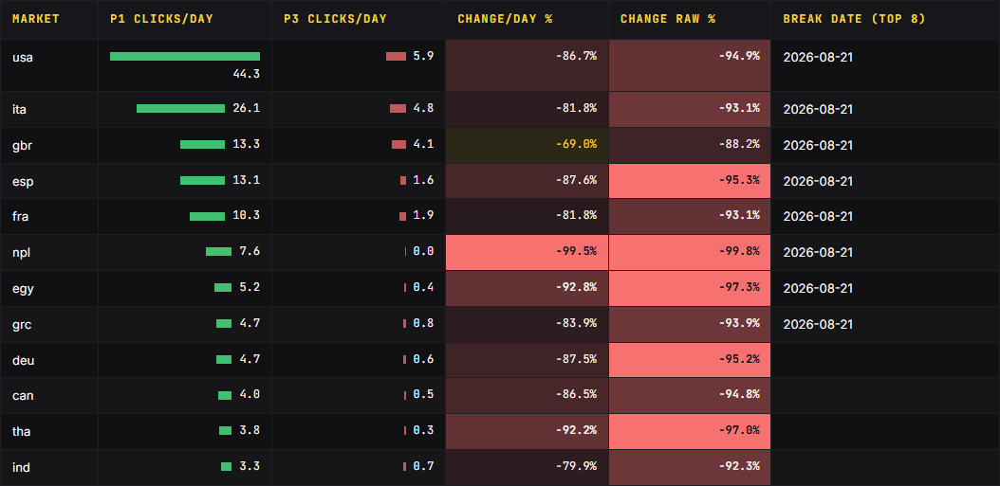
/winston
// 02 · markets
Markets: all 30 markets with 100+ P1 clicks.
No market escaped. On raw totals every one of the 30 markets lost at least 86%. The median loss is -97%.
The deepest are Chile -100.0%, Nepal -99.8%, and Pakistan -99.5%. The US is mid-pack.
e-ita.org · recovery audit · september 2026
11

Slide 12
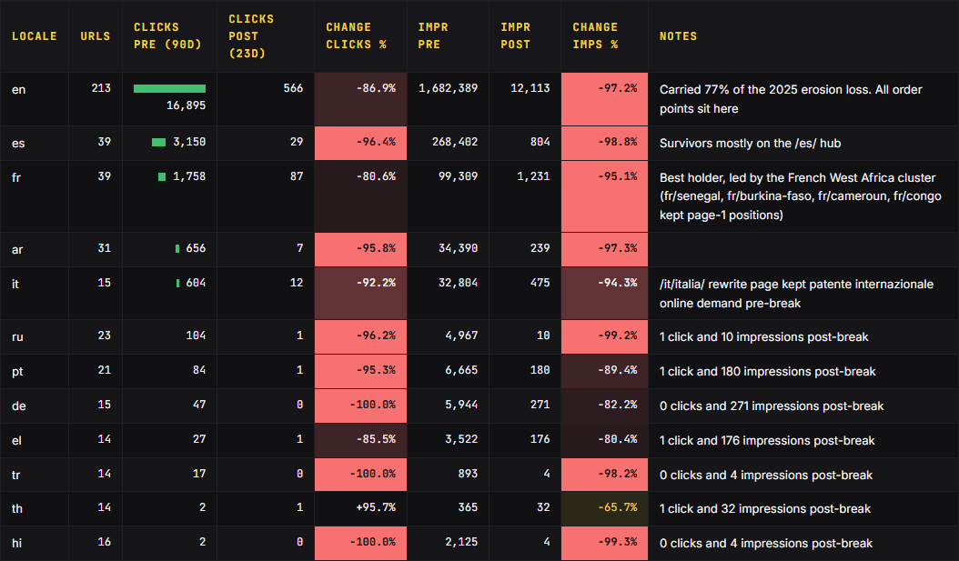
/winston
// 02 · locale
Locale: 12-locale loss table.
English carried the site (-86.9%). All 25 order-bearing pages sit on English pages.
French is the best translated holder (-80.6%, the French West Africa cluster).
e-ita.org · recovery audit · september 2026
12

Slide 13
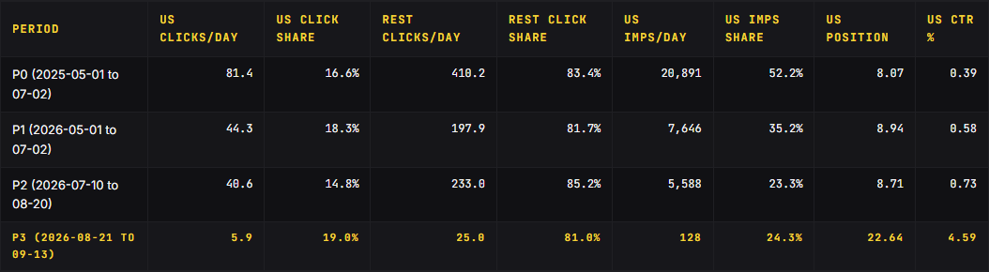
/winston
// 02 · us vs the world
The US drop hypothesis fails.
US click share stayed between 14.8% and 19.0% in every period: 16.6%, 18.3%, 14.8%, 19.0%. The collapse removed traffic from the US and the rest of the world roughly equally.
The kernel of truth is impressions: the US carried 52.2% of all impressions in P0 at a 0.39% CTR. That is about 6x below the median of these 30 markets. That share fell to 35.2% in P1.
e-ita.org · recovery audit · september 2026
13

Slide 14
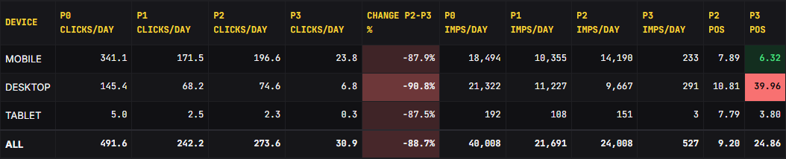
/winston
// 02 · devices
Devices: no device spared, desktop position collapse.
Every device lost 87.5% to 90.8% of daily clicks P2 to P3. The distinctive signal is position, not volume.
Desktop position collapsed 10.81 to 39.96 while mobile improved to 6.32.
e-ita.org · recovery audit · september 2026
14

Slide 15
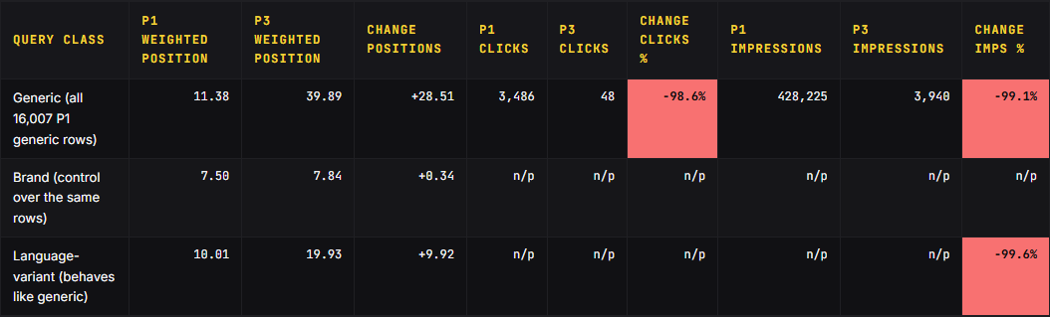
/winston
// 02 · position
Position collapse: generic demotion, brand intact.
Brand weighted position held at 7.50 to 7.84, and head brand terms stayed at 1.0 to 1.6. The collapse is position demotion specific to non-brand query classes, not a demand or reporting artifact.
16 months of positions 8 to 12 on generic head terms prove the pages ranked. This rules out the reading that these pages were never rankable.
e-ita.org · recovery audit · september 2026
15

Slide 16
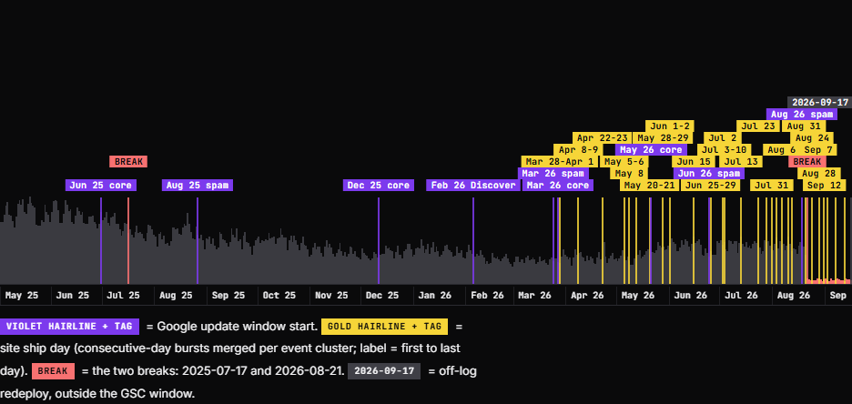
/winston
// 03 · the overlay
503 days, three layers, one chart.
Every dated event carries its source: the release history, the Google update calendar, or a live check. Only the home page broke at ship time.
The drop landed on the final day of the August 2026 spam update.
e-ita.org · recovery audit · september 2026
16

Slide 17
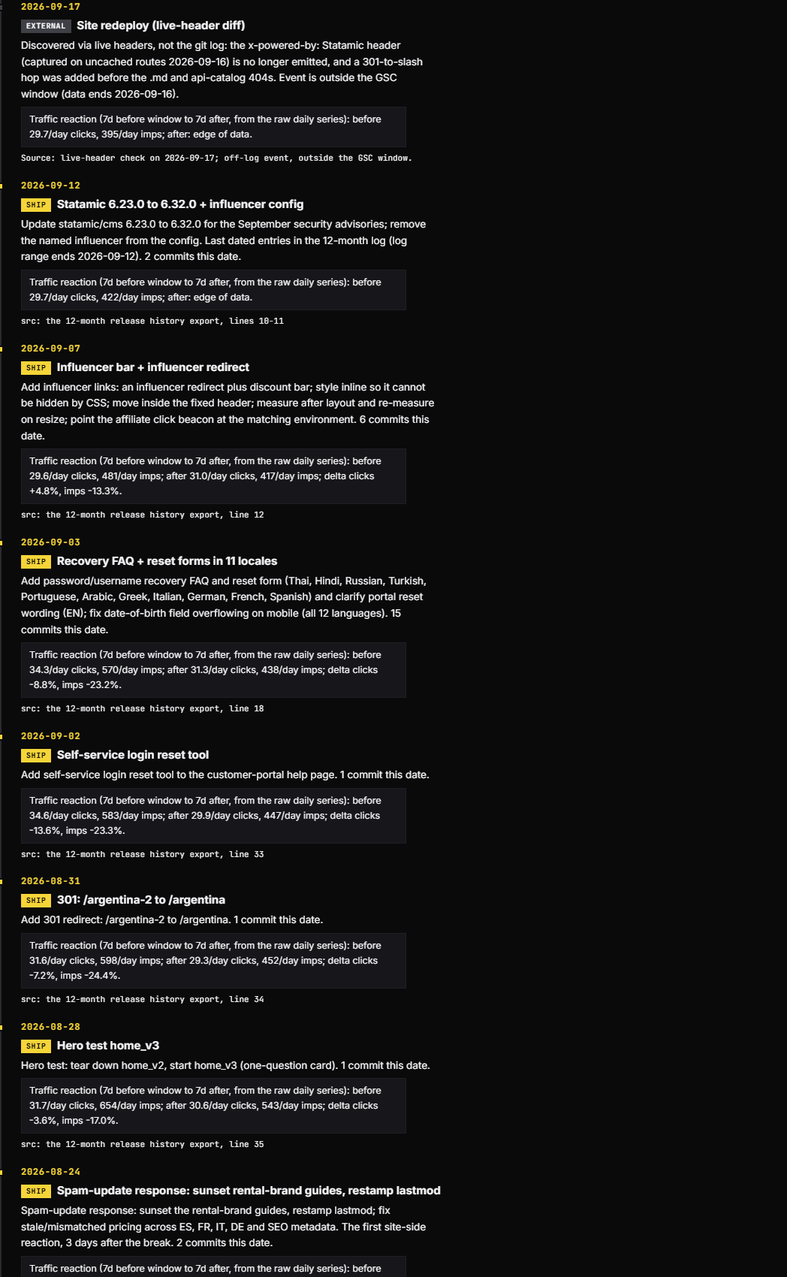
/winston
// 03 · the timeline
9 updates, 56 ship days.
68 events on the timeline: 9 Google updates, 56 ship days, 2 breaks, 1 external redeploy.
Release history against the update calendar: the three load-bearing overlaps. Between the July re-ship (2026-07-03 to 07-10) and the August 2026 spam update, clicks sit on a flat six-week plateau of about 275 a day.
e-ita.org · recovery audit · september 2026
17

Slide 18
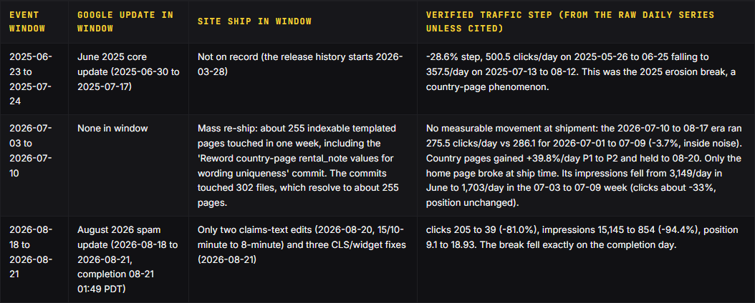
/winston
// 03 · updates vs releases
The verdict.
Shipping it caused no measurable movement: -3.7%, inside normal noise. Country pages grew +39.8%/day P1 to P2 through the re-ship and held to 08-20.
42 to 49 days lag from the mass re-ship to the 2026-08-21 break. The page set had not changed materially for six weeks before it.
Conclusion: both overlapping. The July re-ship, 42 to 49 days earlier, is the probable reason the refresh caught this page set.
The same templated footprint sat through the June 2026 spam update: a -22.4% dip, position unmoved (8.76 to 8.59), full rebound in 4 days.
e-ita.org · recovery audit · september 2026
18

Slide 19
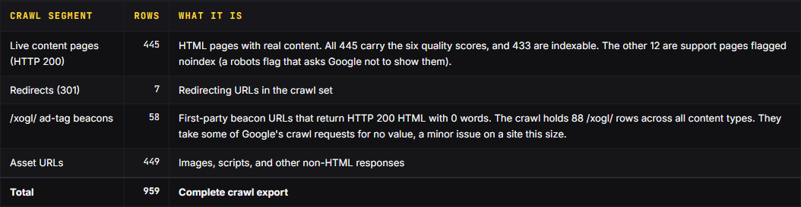
/winston
// 04 · the crawl
The crawl: 2026-09-13.
The crawl ran 2026-09-13 21:34 to 21:46. It captured the live site as it stood that evening. All 445 live pages carry scores. 433 are indexable.
The crawled URL set has no 404s and no 5xx errors. Five security headers are absent on 952 of 959 rows.
e-ita.org · recovery audit · september 2026
19

Slide 20
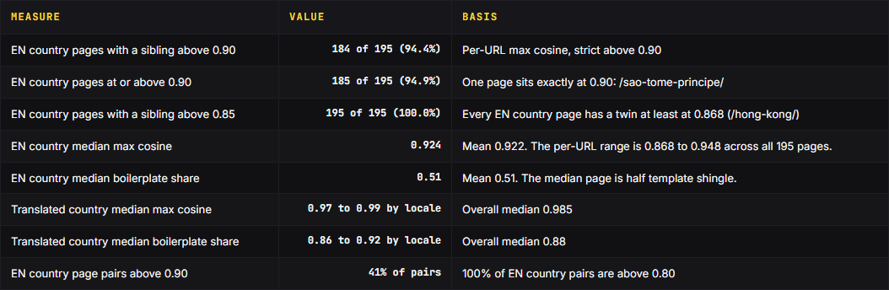
/winston
// 04 · similarity
Similarity scoring.
184 of 195 English country pages have a sibling above 0.90 similarity today. Every EN country page has a twin at least at 0.868.
The median page is half template. The class is the same page with the country name swapped.
e-ita.org · recovery audit · september 2026
20

Slide 21
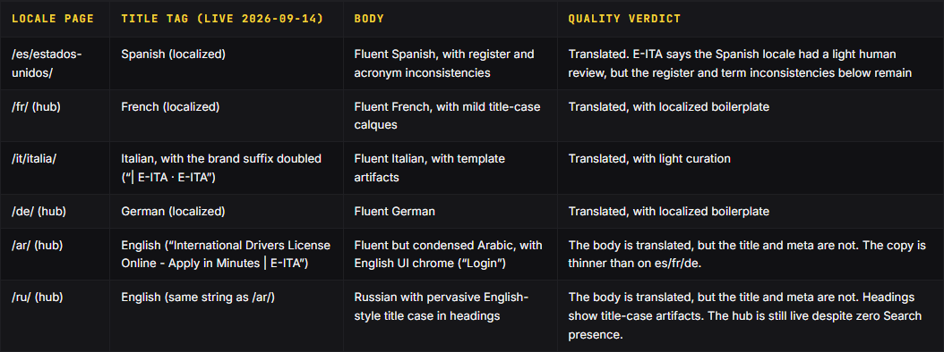
/winston
// 04 · translation
Translation review.
Bodies are translated and fluent. Translation quality is not a cause of the drop. The defects sit in the metadata layer and in curation, not in missing translation. 8 of 11 hubs carry the English title tag, and 7 also carry the English meta description.
Template artifacts. The layer shows doubled brand suffixes in titles, missing H1s on all six sampled locale FAQs, and 65-word refund stubs.
e-ita.org · recovery audit · september 2026
21

Slide 22
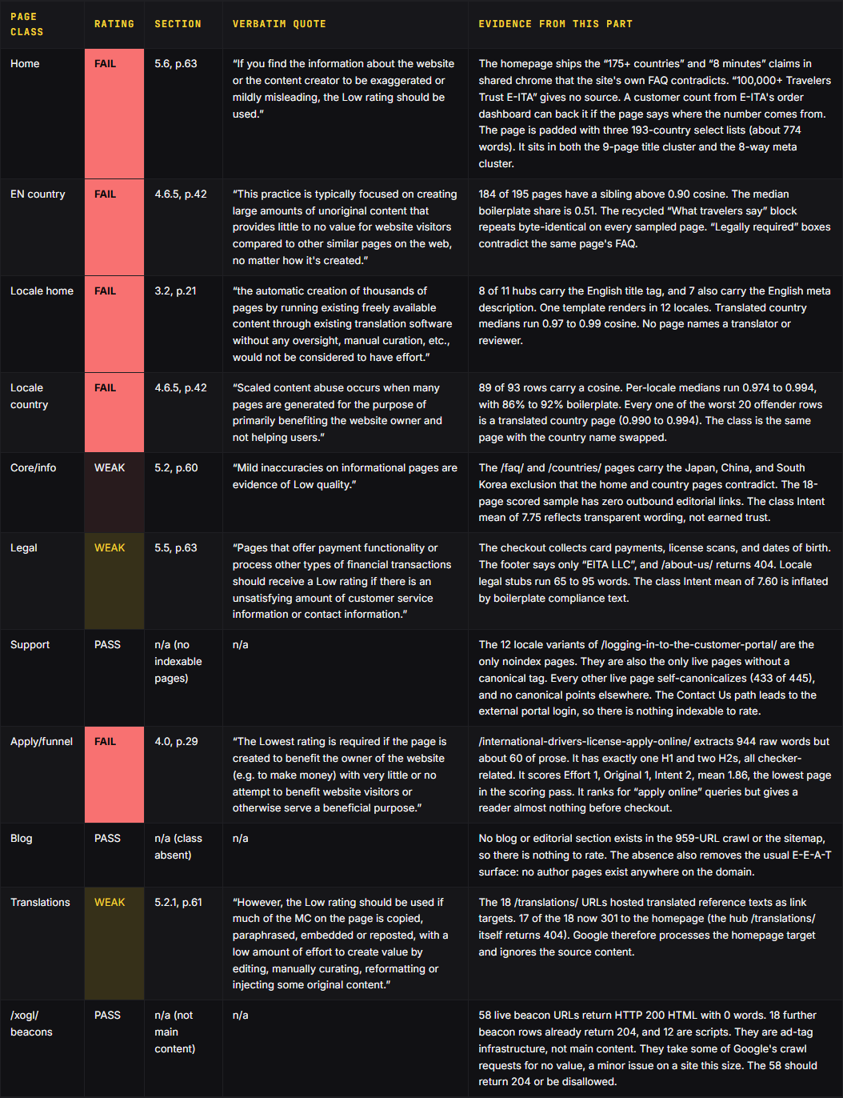
/winston
// 04 · rater guidelines
Page-class scoring against the rater guidelines.
Every class is rated against the Search Quality Rater Guidelines, the helpful content self-assessment, and the spam policies. Rating key: FAIL means the class trips a Lowest or Low trigger in the mapped section. They are an analyst application of the published guidelines to the audited evidence, not Google scores.
8 locale hubs reuse the homepage's English title tag, so 9 pages compete for the same head query while adding little beyond the homepage. A homepage that leads to checkout is normal and is not the issue.
e-ita.org · recovery audit · september 2026
22

Slide 23
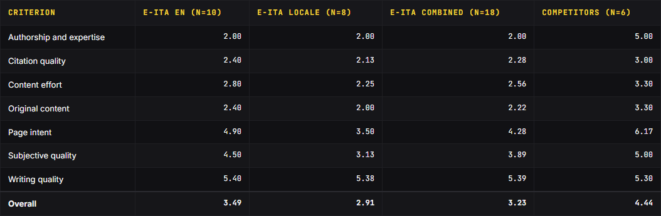
/winston
// 04 · e-e-a-t
E-E-A-T scoring.
On this audit's own E-E-A-T rubric, the site scores 3.23 of 10, against 3.94 for the private-vendor set and 7.00 for the official issuer. 3.94 private-vendor mean, 5 pages (4.44 with the official issuer added).
The fixes are named authorship (the -3.0 gap) and linked official sources on every country page. No crawled page names an author anywhere.
Six cross-cutting defects, verified live on the 18-page sample. All six defects are template-level: each one lifts or sinks every page in its class at once. The testimonial block is already off the site. Zero outbound editorial links. Apply page is a 60-word shell. Anonymous everywhere.
e-ita.org · recovery audit · september 2026
23

Slide 24
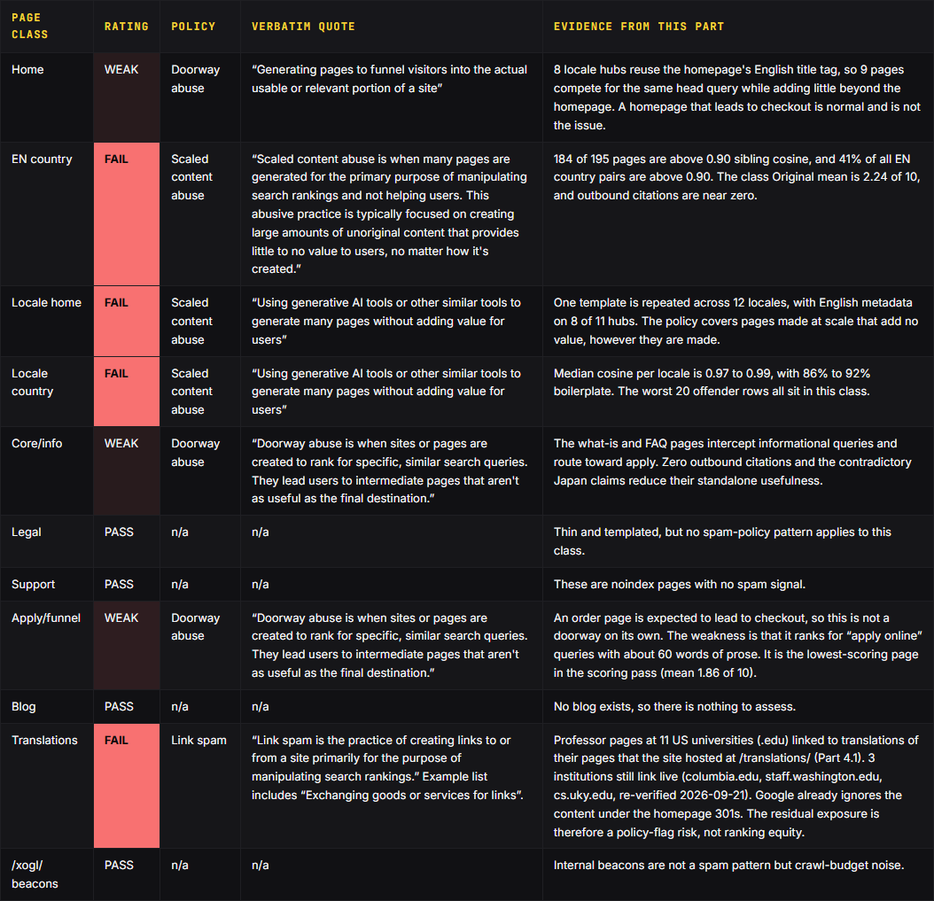
/winston
// 05 · spam policies
The spam-policy exposure.
The spam policies name this pattern: scaled content abuse, 'no matter how it's created'.
Every FAIL is class-wide. Individual exceptions do not rescue a class.
e-ita.org · recovery audit · september 2026
24

Slide 25
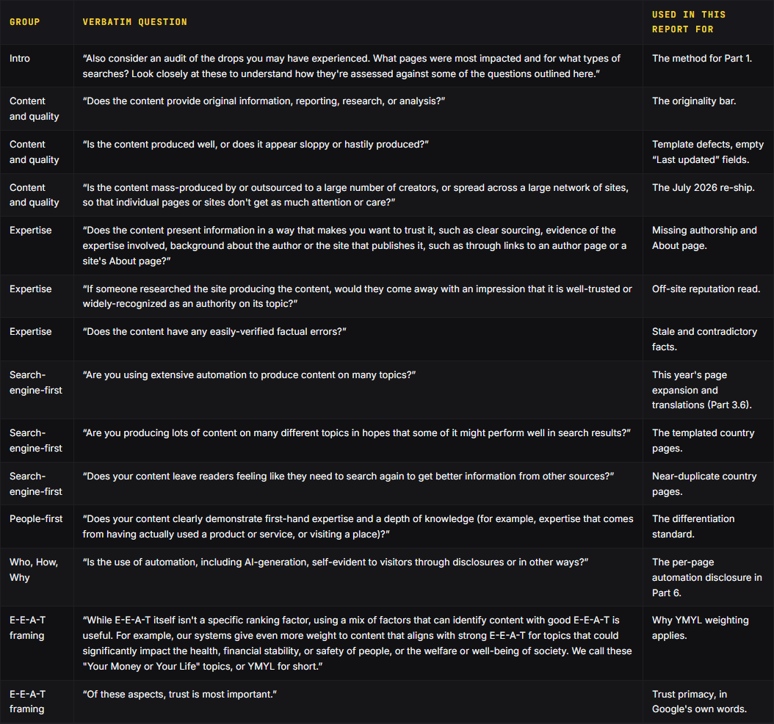
/winston
// 05 · self-assessment
People-first content self-assessment.
184 of 195 pages are above 0.90 sibling cosine. The class fails the attention-or-care test at scale. One template is rendered into 12 locales with shared boilerplate.
No sampled page has an outbound editorial link. /about-us/ returns 404, and no author or reviewer exists anywhere.
e-ita.org · recovery audit · september 2026
25

Slide 26
/winston
// 05 · what this means
What this means.
94.4% of EN country pages have a sibling above 0.90 cosine. Translated country pages run at a median of 0.97 to 0.99. Cutting pages shrinks the set. It does not make any surviving page less similar to its class.
Quality has no gradient. Keep, rewrite, fold, and kill buckets score within fractions of a point of each other, and no score correlates with pre-break clicks above 0.22. On these scores the best and worst pages look alike, so these scores don't explain which pages ranked.
The policy frame fits the evidence closely. The spam policies name scaled content abuse 'no matter how it's created'. Using AI is not the problem. Near-identical pages at scale are.
Only template fixes move scores. The fixes are named authorship (the -3.0 gap) and linked official sources on every country page. They also include requirement labels that match the rest of the page (the Intent gap) and translated metadata on the 8 English-language hubs.
The one above-norm asset is writing quality (5.39 vs 5.30). The prose holds up, and the gaps sit in identity, sourcing, and consistent claims.
Add no country or locale page the plan does not name. Make each fix once in the shared template, not page by page. Ship the authorship layer. Link the official source behind every country page that stays. Make each country's requirement label match the rest of its page. Translate title tags and meta descriptions on the 8 English-metadata hubs. Have a native speaker translate or edit the es, fr, it, and ar pages that stay. Go ahead with the fold and kill verdicts.
e-ita.org · recovery audit · september 2026
26

Slide 27
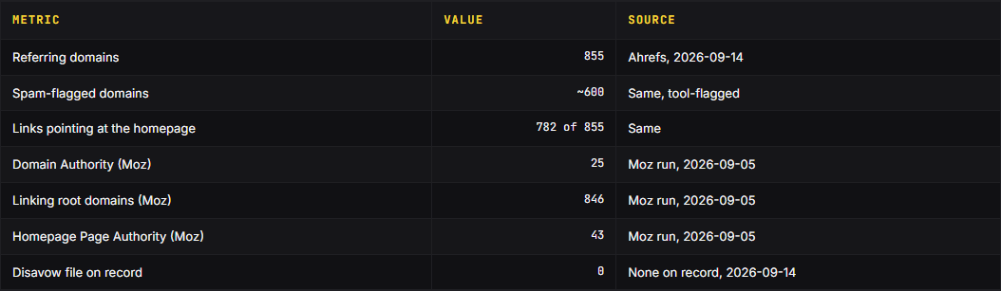
/winston
// 06 · link profile
The link profile.
About 600 of 855 referring domains are spam-flagged, and 782 of 855 point at the homepage. 0 disavow files on record, 2026-09-14.
Steady directory and backlink-agency spam has arrived since November 2025.
The evidence points away from competitor sabotage. Four named network domains were verified live on 2026-09-14. The practical answer doesn't depend on who placed them.
e-ita.org · recovery audit · september 2026
27

Slide 28
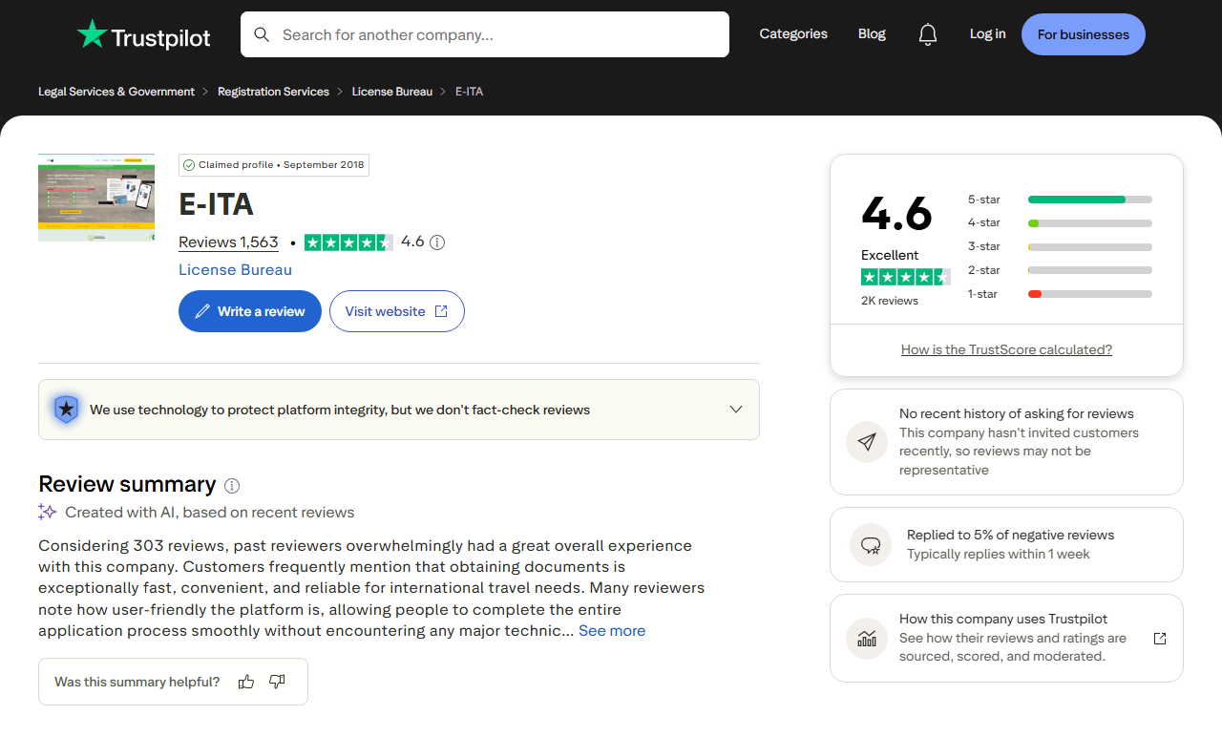
/winston
// 06 · brand sentiment
Brand sentiment.
Trustpilot reads 4.6 stars (2026-09-22) with about 11% 1-star reviews. The category leader, the International Drivers Association, read 4.9 stars with ~4% 1-star on 2026-09-05 and replied to every visible review, negatives included, on 2026-09-14.
In the early-September sweep, all 4 sampled AI engines (ChatGPT, Gemini, Perplexity, Claude) advised against using the site.
A set of old hostile threads from 2019 to 2022 still ranks for the brand. These threads can't be removed, and they are what AI engines quote. Run the review program and reply parity on Trustpilot (Part 6 Phase 1).
e-ita.org · recovery audit · september 2026
28

Slide 29
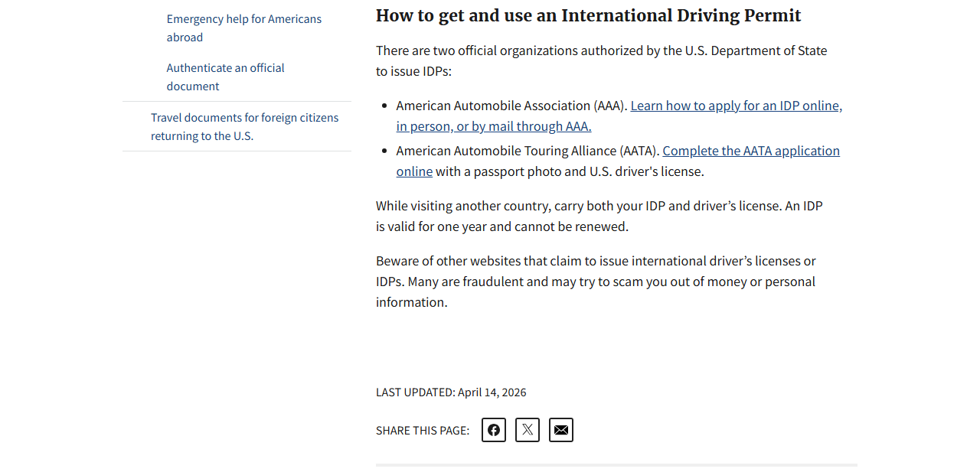
/winston
// 06 · the official frame
Third-party corroboration and entity identity.
The FTC consumer alert names AAA and AATA as the only authorized US issuers of IDPs. The official figure is the U.S. Department of State's 'more than 150 countries' (7 FAM 1436 a, text dated 2015-11-05). It counts countries that honor official IDPs, which the booklet is not.
On 2026-09-29 the homepage FAQ said the IDL 'is accepted in 175+ countries worldwide, including the USA, UK, Australia, Japan, and most of Europe'. The site's own FAQ, /countries/, and terms pages exclude Japan, South Korea, and mainland China. By 2026-10-05 the homepage answer no longer named Japan.
The site markets an 'International Driver's License' (IDL). The official document governments recognize is the International Driving Permit (IDP). EITA LLC is real: California #201900410571, filed 2019-01-01, good standing.
e-ita.org · recovery audit · september 2026
29

Slide 30
/winston
// 07 · ranked causes
Ranked cause assessment.
Rank 1. Automated demotion across the whole site on the final day of the August 2026 spam update. CONFIRMED for timing, breadth, and no manual action. PROBABLE that a spam classifier caused it.
Rank 2. Scaled content abuse: the 2026-07-03 to 07-10 mass re-ship. Probably the page set the update caught. Rank 3. Thin trust signals and a split reputation on a YMYL topic. CONFIRMED for the facts. PROBABLE that they cap recovery.
Rank 4. Standing risk (link spam through aliases, dormant clone), not the trigger. Rank 5. Link spam: about 600 of 855 referring domains spam-flagged. Ruled out for this update, but a standing risk.
e-ita.org · recovery audit · september 2026
30

Slide 31
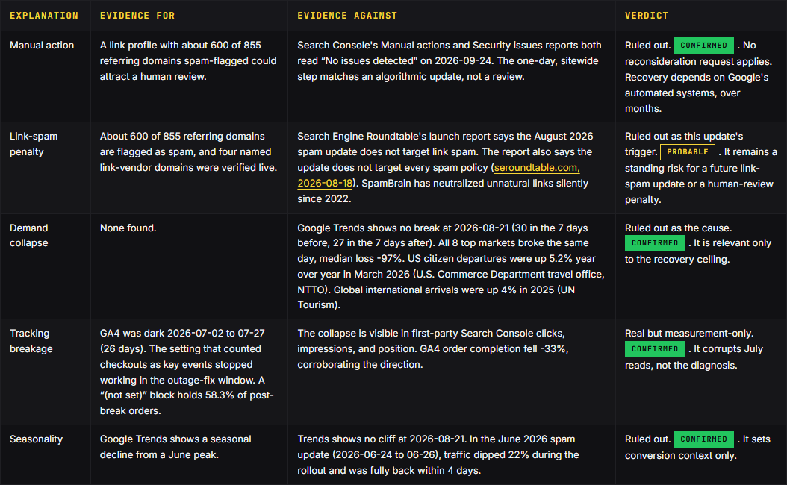
/winston
// 07 · alternatives
Ruling out the simpler explanations.
Five alternative explanations were tested against the evidence. The collapse is a single-day, sitewide, non-branded step on the final day of the August 2026 spam update. None of the five alternatives explains that signature.
Search Console's Manual actions and Security issues reports both read 'No issues detected' on 2026-09-24.
e-ita.org · recovery audit · september 2026
31

Slide 32
/winston
// 08 · pages in scope
The verdict sheet classes all 454 audited URLs.
73
keep
70
rewrite
149
fold
162
kill
The four classes are keep, rewrite, consolidate, and retire. Fold means consolidate (a 301 into a hub). Kill means retire (a 410). This map covers all 311 fold and kill URLs plus 30 URLs that have no verdict row. The 30 are 14 rental-brand guide redirects, 4 legacy aliases, and 12 pre-migration paths from GA4 landing-page data. The 18 retired /translations/ pages wait on the decision about the university (.edu) links that point at them (Part 4).
The Planned action column is the deploy plan, not the current state. The live columns show what each old URL and target returned on 2026-10-05.
The verdict sheet and redirect map ship as their own pages and files, because the steps work from them.
e-ita.org · recovery audit · september 2026
32

Slide 33
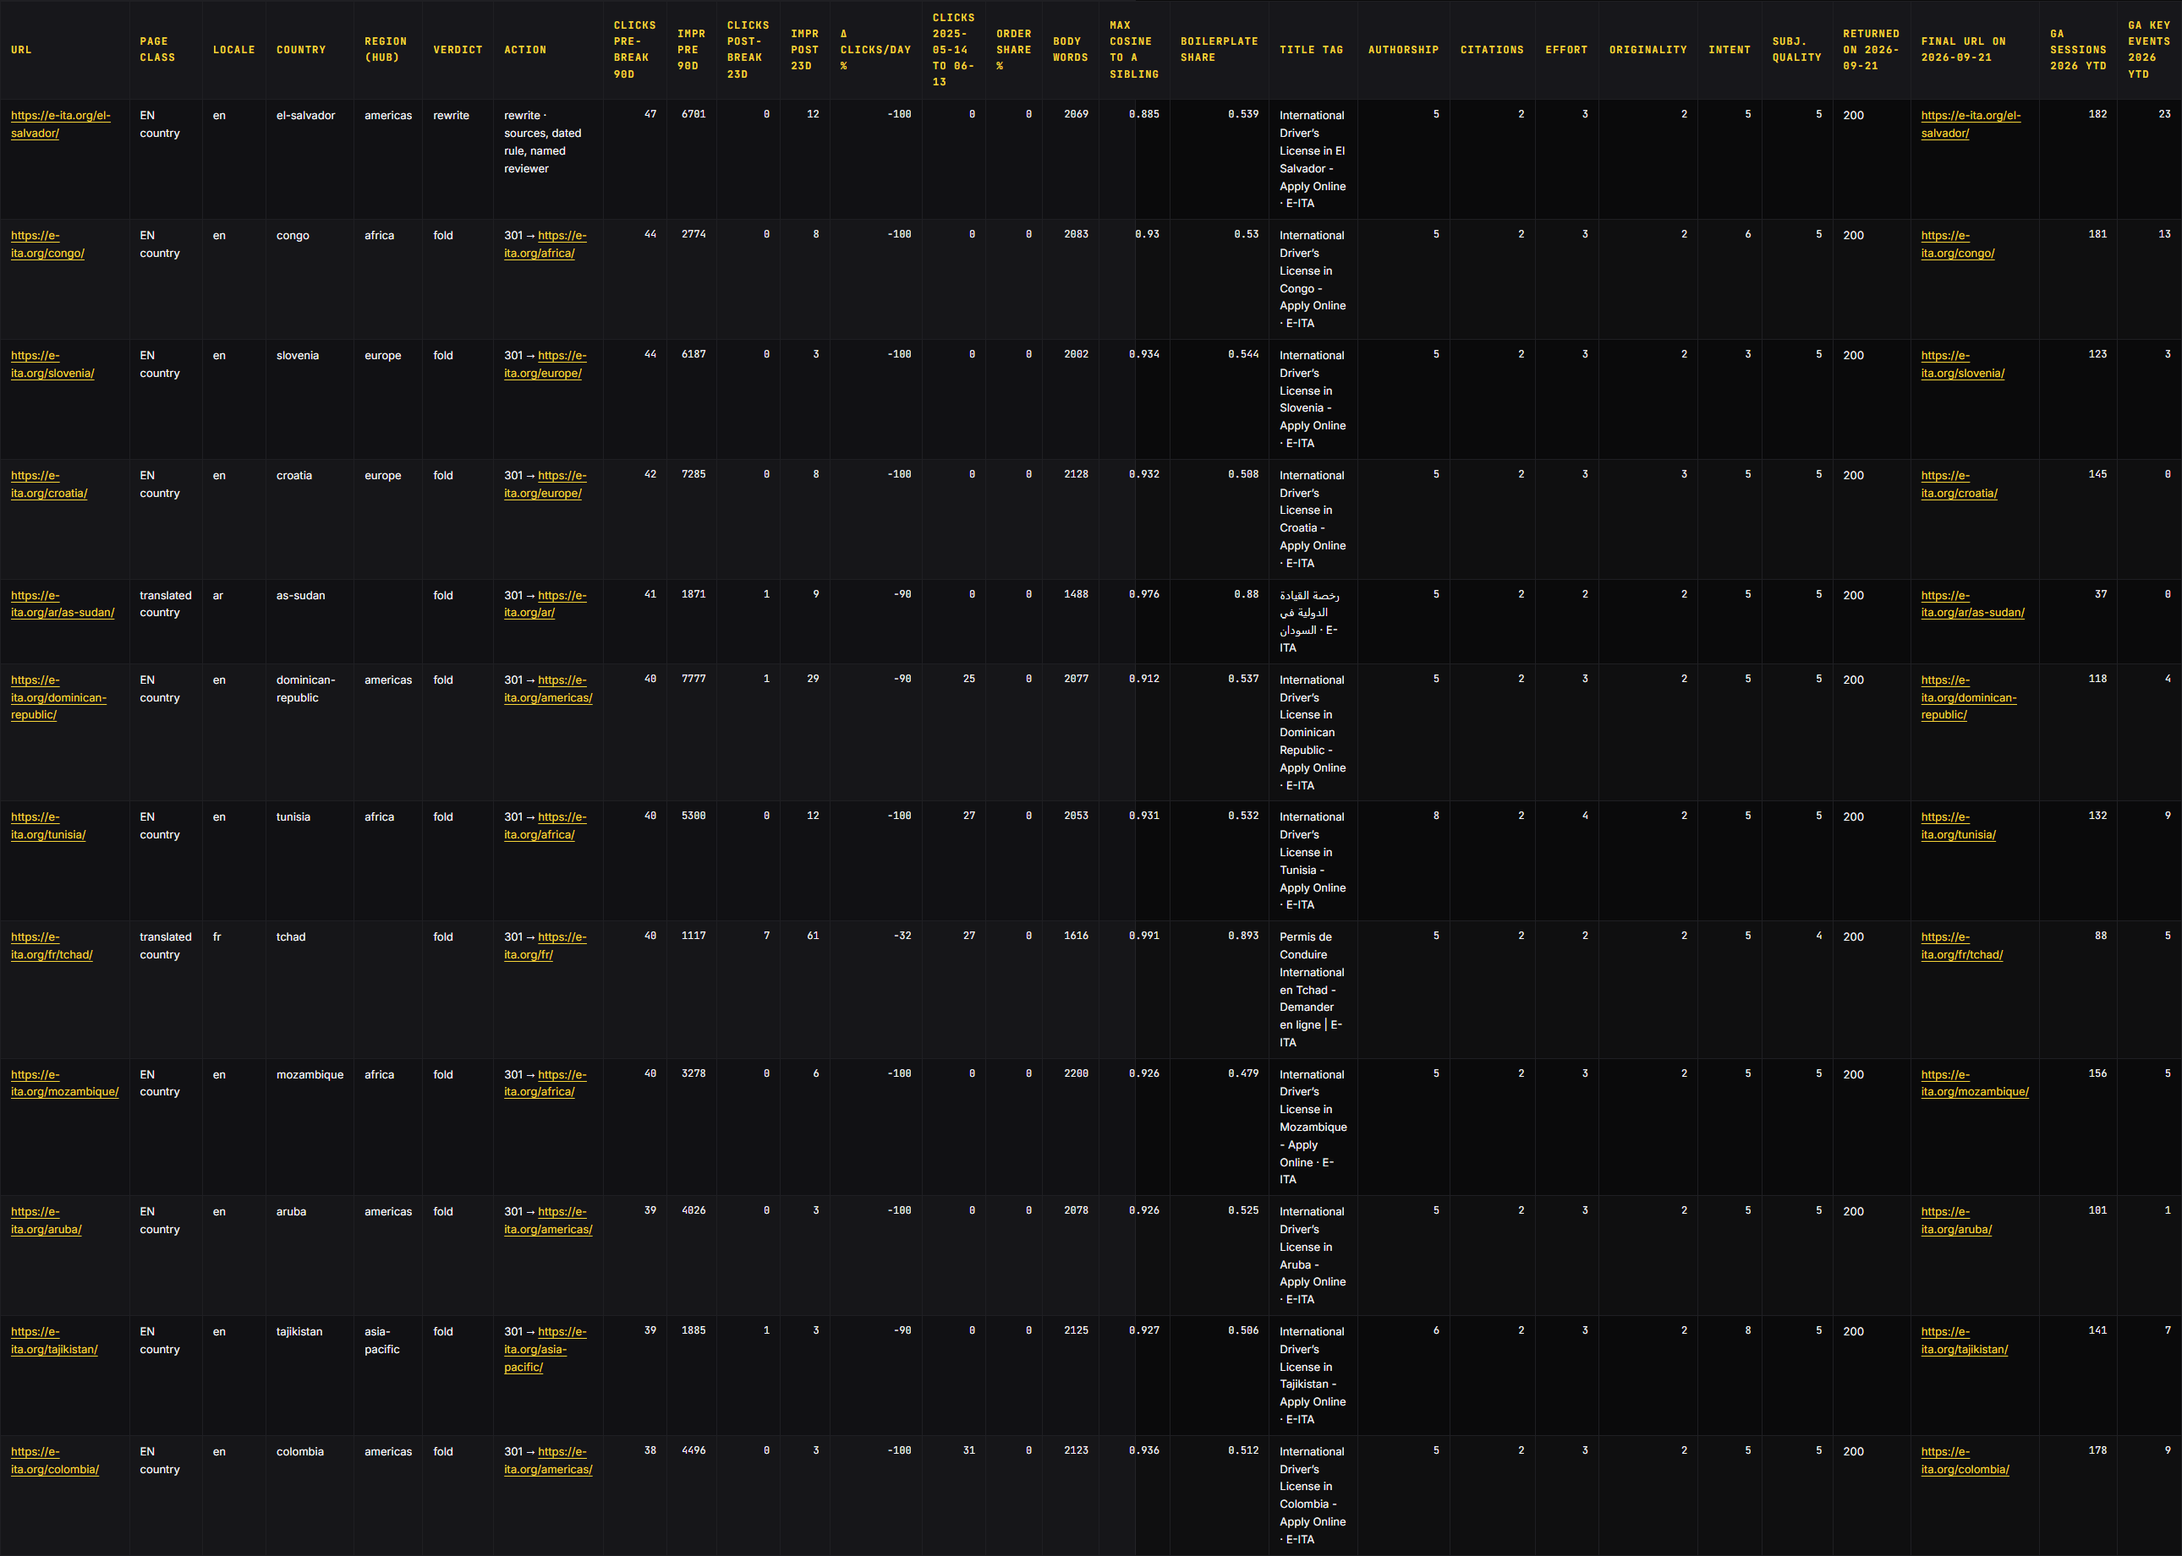
/winston
// 08 · the verdict sheet
Page-class verdict sheet: 454 URLs.
One row per URL. Verdicts: keep 73, rewrite 70, fold 149, kill 162. Rewrite is the only bucket that needs writing.
The GA columns are the GA4 landing-page export (all users, all channels, 2026-01-01 to 2026-09-26).
e-ita.org · recovery audit · september 2026
33

Slide 34
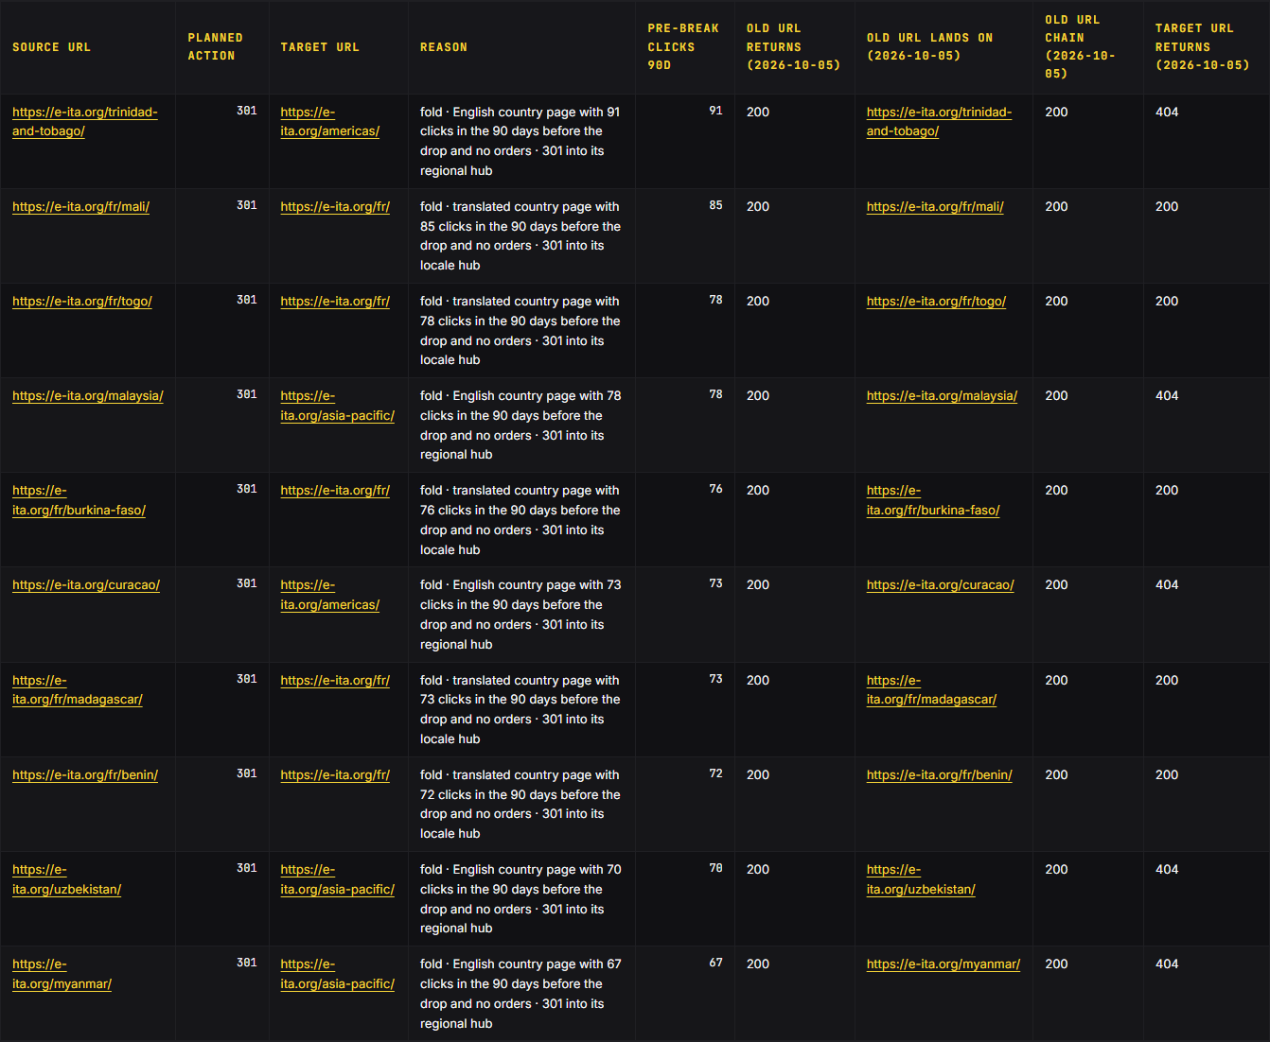
/winston
// 08 · the redirect map
Consolidation and redirect map: 341 rows.
The plan redirects 179 rows (301) to the closest matching page and removes 162 rows (410).
15 rows can ship now, including 11 of the 12 pre-migration rows (-uk/ to /united-kingdom/ among them). The 35 rows that fold translated country pages into /es/, /fr/, and /ar/ ship as each locale hub gains a row for that country. Stage 3: ship the 129 rows that point to the 6 new hub and guide pages. Stage 4, after E-ITA reviews the fold and kill lists: ship the 162 rows that return 410.
e-ita.org · recovery audit · september 2026
34

Slide 35
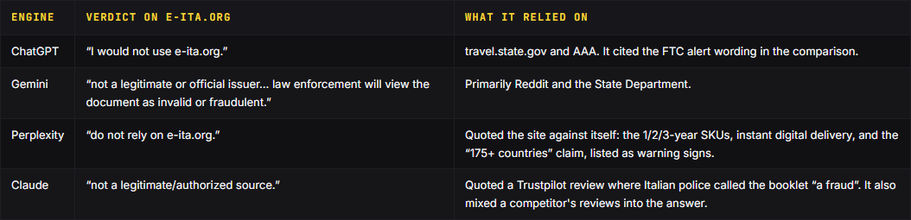
/winston
// 09 · ai-search
AI-search standing.
All 4 tested AI engines advised against the site in early September. The early-September baseline is 4 of 4 negative, anchored on the FTC alert, the forum threads, and the site's own claims.
On 'best place to get an international driving permit online 2026?', every engine names AAA as the only fully legitimate option.
e-ita.org · recovery audit · september 2026
35

Slide 36
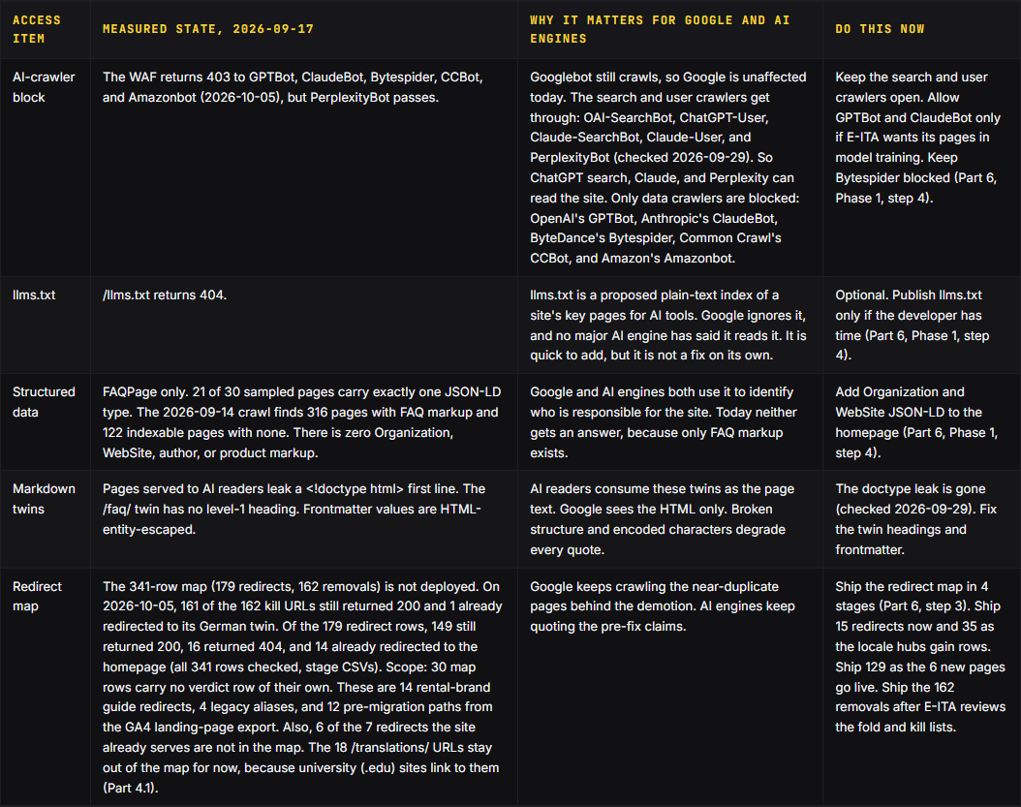
/winston
// 09 · access layer
Crawler and access layer, checked 2026-09-17.
The WAF returns 403 to GPTBot, ClaudeBot, Bytespider, CCBot, and Amazonbot (2026-10-05), but PerplexityBot passes. /llms.txt returns 404. FAQPage only. Organization and WebSite are absent.
The search and user crawlers get through: OAI-SearchBot, ChatGPT-User, Claude-SearchBot, Claude-User, and PerplexityBot (checked 2026-09-29). The block stops the data crawlers GPTBot, ClaudeBot, Bytespider, CCBot, and Amazonbot. Google is not affected.
e-ita.org · recovery audit · september 2026
36

Slide 37
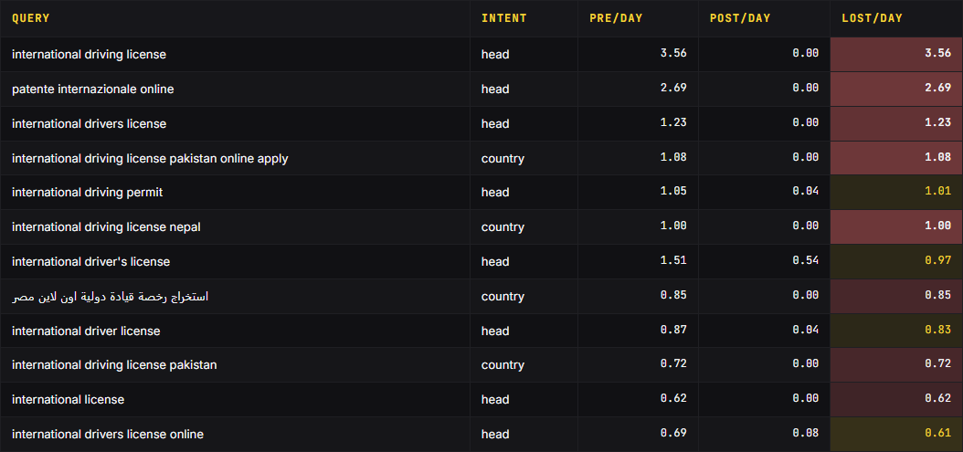
/winston
// 09 · demand
Where the lost demand sits.
The demand map ranks what was lost, by query, by intent, and by the country each query names.
Query exports cover the identifiable slice: 94.9 of 275.5 pre-break daily clicks, and 15.4 of 30.9 post-break.
e-ita.org · recovery audit · september 2026
37

Slide 38
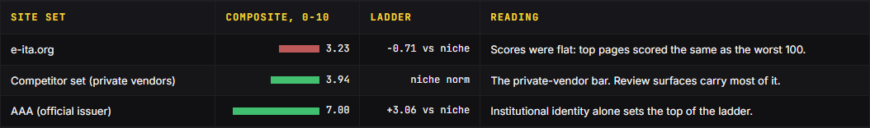
/winston
// 09 · trust ladder
Trust sets the category ceiling.
On this audit's own E-E-A-T rubric, the site scores 3.23 of 10, against 3.94 for the private-vendor set and 7.00 for the official issuer.
Even the strongest private vendor trails the official issuer by 2.00 points.
e-ita.org · recovery audit · september 2026
38

Slide 39
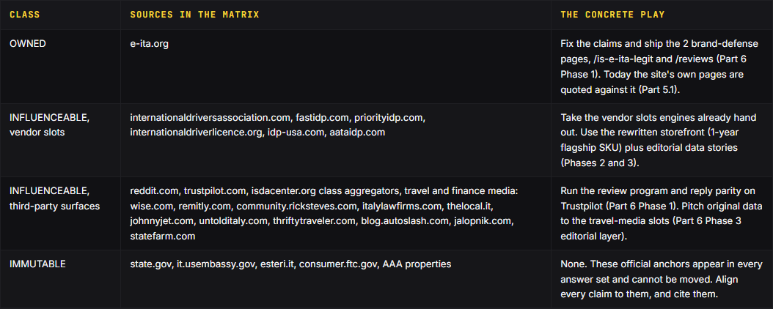
/winston
// 09 · the supply chain
The AI answer supply chain.
The early-September four-engine answer sweep captured every source domain.
The slots exist. Fast IDP holds a Q3 slot and PriorityIDP a Q1 slot (Part 5.1). The right-hand column shows the Part 6 asset for each.
e-ita.org · recovery audit · september 2026
39

Slide 40
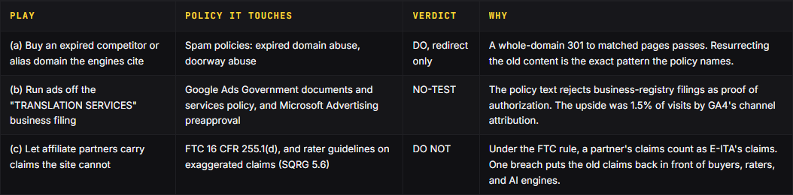
/winston
// 09 · the grey plays
The grey plays, scored.
Three plays surfaced during the audit that sit near policy lines. Each is scored against the documented policy text.
Verdicts are DO, DO NOT, or NO-TEST. Google Ads policy states that an authorized provider's domain must be 'linked from an official government website and explicitly referenced as authorized'.
e-ita.org · recovery audit · september 2026
40

Slide 41
/winston
// 09 · market context
Demand was flat.
Global international arrivals grew 4% in 2025 to 1.52 billion (UN Tourism, 2026-01-20). NTTO's March 2026 release shows US citizen departures up 5.2% year over year.
The monthly figures swing, so read a single month as a reading, not a trend.
Category demand did not break. Google Trends for 'international driving permit' in the US (daily index, read 2026-09-16) averaged 30 in the 7 days before 2026-08-21. It averaged 27 in the 7 days after.
Verdict: demand did not collapse. Google Trends moved from 30 to 27 across the break, against an 88.8% click loss. Demand is ruled out as the cause.
e-ita.org · recovery audit · september 2026
41

Slide 42
/winston
// 09 · measurement integrity
What the analytics can prove.
Conversion tracking cannot currently certify the size of the business loss. GA4 recorded zero visits for 26 straight days, 2026-07-02 to 07-27, while Search Console clicks ran 214 to 340/day. The setting that counted checkouts as key events stopped working in the 2026-07-02 to 2026-07-28 outage-fix window. generate_lead events make up 86.5% of key events since the collapse (4,661 of 5,390). 68% of them come from visits GA4 labels '(not set)', which started on 2026-07-28, the day tracking came back. Those visits are 19.4% of all visits and carry 58.3% of completed orders.
What survives audit: order_complete fell 45.5/day to 30.4/day (-33%). Daily orders attributed to organic search fell 92%, tracking the click collapse almost exactly. Revenue was never sent to GA4, so no dollar figure exists in analytics.
Any dollarized loss claim is unverifiable today. Clean instrumentation is a precondition for any dollarized claim.
Optional: identify what fires generate_lead and the '(not set)' visits. Tag it or exclude it. Track absolute daily completed, non-test order counts, plus monthly revenue and AOV. Count orders from E-ITA's order dashboard. Do not quote raw key events until the identity gap closes.
e-ita.org · recovery audit · september 2026
42

Slide 43
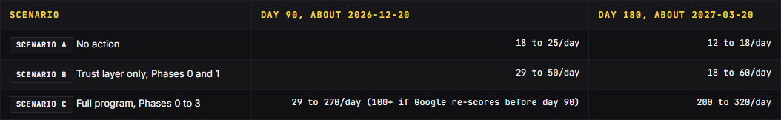
/winston
// 09 · scenarios
Recovery scenarios.
The recovery scenarios are read at day 90 (about 2026-12-20) and day 180 (about 2027-03-20), counted from the 2026-09-21 audit baseline.
The scenarios are planning ranges, not promises.
Rebound 1 multiplied trough clicks by 1.69 in about 15 weeks. The floor is 30.9, minus the roughly 2.0/day trickle the redirect map removes: about 29. The 100 figure (30% of the 244.6/day loss restored) is a target, not an anchor. The June 2025 core retention ratio, 365.9 of 467.2, is 78%. Held against the 270 path, that is about 211, rounded down to 200.
e-ita.org · recovery audit · september 2026
43

Slide 44
/winston
// 10 · why not roll back
Why not roll back.
Should the site roll back to an earlier version? No. The archive snapshots from 2024 to 2026 show that every earlier version carried the same page template and the same claims. The release history (from 2026-03-28) shows the same for every version since then.
Older code would also reopen security holes that have since been patched: the release log records Statamic security updates on 2026-06-27 and 2026-09-12 (Part 2).
Rolling back would not remove what Google demoted. The phased rebuild is built to remove it.
e-ita.org · recovery audit · september 2026
44

Slide 45
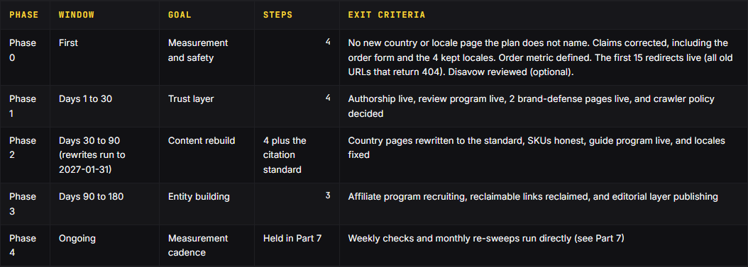
/winston
// 10 · the phases
5 phases, run in order.
Work the phases in order. The weeks and dates in this plan are a recommended order, not deadlines.
15 steps, each with an acceptance check. Ship 15 redirects now, and only those 15. Part 6 is the full implementation guide, and Part 7 is the measurement framework.
The recommended targets are these: every row of the redirect map working by 2026-11-15, and all 70 rewrites live by 2027-01-31. Recovery is judged against thresholds set before any recovery data existed, with a final read on 2027-03-31 (Part 7).
e-ita.org · recovery audit · september 2026
45

Slide 46
/winston
// 10 · phase 0
Phase 0: first (measurement and safety).
Step 1. Ship the claims fix. Keep a country number E-ITA can back, and drop the words 'accept', 'accepted' and 'valid'. Publish the exclusion list. Keep the 8-minute line with the condition from the Terms. Say what the higher-fee urgent option adds. Make the same edits on the order form at apply.e-ita.org. It serves 2 variants at random, a one-page form and a 5-step form. Why: on 2026-09-29 the homepage contradicted the site's own FAQ, and Perplexity listed the '175+ countries' claim as a warning sign (Part 3.3, Part 5.1).
Step 2. Set the measurement rules. Count orders from E-ITA's own order dashboard, which already tracks them. Log every deploy in the change log on the day it ships. Treat GA4 figures from 2026-07-02 to 07-27 as void. Why: 86.5% of GA4 key events since the collapse are not orders, and dated deploys separate site changes from Google updates (Part 5.5).
Step 3. Ship 15 redirects now, and only those 15. The other 164 redirects wait: 129 until their target pages exist, and 35 until each locale hub has a row for that country. The 162 removals wait for E-ITA's review. Start with /international-drivers-license-uk/ to /united-kingdom/.
Why the kills return 410, not 301. Google can treat a redirect to an unrelated page as a soft 404. The plan uses 410 because it says the removal is deliberate.
Step 4. Review, then file, the disavow (optional insurance). Review it by hand, then upload only what passes the review.
Acceptance check: the repository search and a full crawl find no 'accepted in' or 'valid in' country claim, in any language. The source also shows no '10 minutes', no 'Valid Worldwide', no 'Instant Approval', and no 1949 Convention claim. Every '8 min' line carries the condition from the Terms. Each page with an 8-minute line also says once what the urgent option adds (copy pack S3). If a file is filed, it holds only reviewed entries.
e-ita.org · recovery audit · september 2026
46

Slide 47
/winston
// 10 · phase 1
Phase 1: Days 1 to 30 (trust layer).
Step 1. Ship the authorship layer: named entity, physical address, named author and reviewer, schema. Why: no page names a person, on a topic where the rater guidelines check who stands behind the advice (Part 3.5). Until a named person is approved, keep the 73 keep pages on an 'EITA editorial team' byline with a named reviewer role.
Step 2. Start the reviews program. Confirm the Trustpilot plan first, then turn on automatic invitations. Reply to 100% of new negative reviews within 48 hours.
Step 3. Publish /is-e-ita-legit. Answer in the first paragraph. Publish /reviews as 1 canonical page. Also publish an About page and a real contact page. Why: checkout collects card details and license scans, yet /about-us/ returns 404 and the only 'Contact Us' link opens the portal login (Part 3.4). Keep the eitalicense.com clone down. It returned 403 on 2026-10-05. If it comes back, 301 each of its pages to the matching e-ita.org page.
Step 4. Write the crawler decision down in 1 paragraph. Keep the search and user crawlers open. Allow GPTBot and ClaudeBot if E-ITA wants its pages in what those models learn. Keep Bytespider blocked, because no official IP list exists to verify it. Verify bots by IP address, not by user-agent string alone. If E-ITA wants it, publish /llms.txt as plain text. This step is optional. Add Organization and WebSite JSON-LD to the homepage, with the legal name.
Acceptance check: every rewritten page shows a named author and reviewer with working bio links. Every keep page shows at least the editorial-team byline, linked to the About page. A probe with each of the 5 search and user crawlers returns 200, and so does each training crawler the decision allows.
e-ita.org · recovery audit · september 2026
47

Slide 48
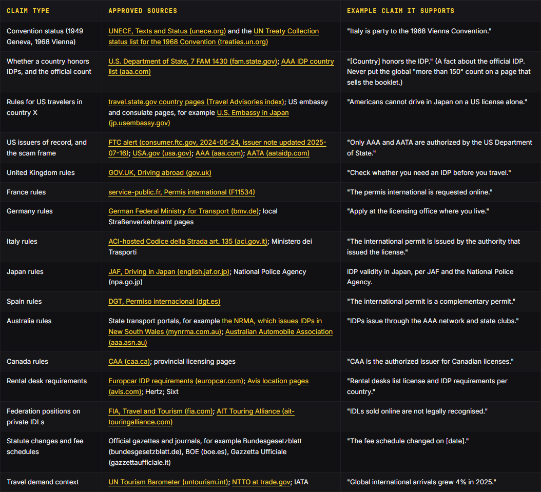
/winston
// 10 · phase 2
Phase 2: Days 30 to 90 (content rebuild).
The content rebuild replaces the templated country pages with pages a rater can tell apart. Clone the model pages, and do not invent a new shape. Ship the 25 order-bearing pages first.
At least 10 facts that appear on no other country page. At least 6 primary sources, each with an accessed date. Below 30% shared n-gram overlap with every sibling page. A named author and reviewer. Plan for about 800 to 1,500 words. It is not a pass mark.
Replace multi-year SKUs with renewal plans. Build the country-guide program on original data. Who: the developer patches the locale template once.
The Content Skill Walkthrough deck shows the cycle end to end.
e-ita.org · recovery audit · september 2026
48

Slide 49
/winston
// 10 · the citation standard
The citation standard.
Every rebuilt page stands on citations. The IDP topic is YMYL, so the scrutiny standard is high. The rule of thumb: the official source wins. When sources conflict, the page states the conflict and defers to the more authoritative source.
The whitelist: approved sources by claim type. Trace every acceptance claim to convention status or an issuer of record, never to marketing copy.
The blacklist: source types to never cite. Rival IDP vendors. A citation endorses a competitor. Lookalike and scam operators. Wikipedia, Wikisource, and mirrors. Expat and travel blogs. Forums and Q&A sites. Scraped or stale aggregators. Sites that sell coverage.
Carry at least 6 primary outbound citations per country page, one for each source type in the coverage rule. That includes at least 1 government or club authority and 1 rental company source. Cite the specific statute or page, not the domain home page. Keep the citation next to the claim it supports, in the same passage.
Every source line carries an accessed date in YYYY-MM-DD form. Re-verify the 10 first-batch pages (the priority markets) monthly and all other country pages quarterly. Reflect any source change within 30 days, with a change-log entry.
e-ita.org · recovery audit · september 2026
49

Slide 50
/winston
// 10 · phase 3
Phase 3: Days 90 to 180 (entity building).
Step 1. Stand up tracking before recruiting anyone. Recruit rental agencies first, because the buyer's moment of need is the rental counter. Vet every partner before approval for a real business and real traffic. Put the disclosure clause in partner terms from day one: partners must disclose the paid connection (16 CFR 255.5(a)). Never buy links for ranking. Why affiliates: from 2026-10-05, Google's government documents and services ads policy limits those ads to authorized providers.
Step 2. 301 every dead URL that still holds external links to the live page that now carries the linked content. Bulk redirects to the homepage discard the topical signal that made the link worth having. Run unlinked-mention reclamation on coverage that names the brand without a link. Warm requests convert at 15% to 40%. Check the 4 alias domains for their own history: past content and outside links.
Step 3. Open a news-and-guides section under named authors, with the sourcing rules and citation standard. Ship 1 maintained dataset per quarter, built on official sources. The first candidate is a country-by-country table of what a visiting driver needs. Pitch original data only. Cap each campaign at about 100 personalized sends.
Stay out of Reddit while the 2022 scam thread stands. Participation now reads as astroturfing. After the claims fix is verified and the thread's premise is weakened, start the real-person answering program. Use 1 named account with 30+ days of genuine participation before any brand mention. Put a disclosure line in every brand-adjacent answer. Post mentions, not links.
e-ita.org · recovery audit · september 2026
50

Slide 51
/winston
// 10 · phase 4
Phase 4: Ongoing (measurement cadence).
Recovery is declared by data, not by effort. Part 7 sets the scorecard in advance, with 6 readiness checks and the weekly numbers. Google's September 2026 spam update started on 2026-09-24, with a rollout of up to two weeks. No read uses days inside the rollout.
'Making changes may help a site improve if our automated systems learn over a period of months that the site complies with our spam policies.' The timeline runs through months, not days.
Sequencing principle: do not re-order the phases to front-load content work. Why: a rewrite cannot ship until its named author and reviewer exist (Phase 1, step 1). Rewrites also build on the corrected claims from Phase 0.
Read Part 7 before the removals start. The expected dip starts as soon as the removed pages go. In the recommended order, expect traffic to dip from 2026-10-19 to 2026-12-06 while removed pages leave the index. The plan names that dip in advance so it is not misread as failure.
e-ita.org · recovery audit · september 2026
51

Slide 52
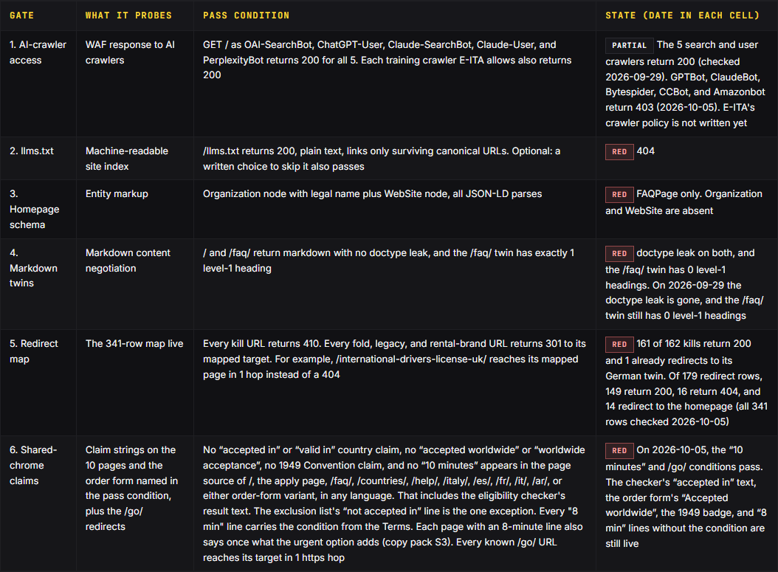
/winston
// 11 · readiness gates
0 of 6 readiness gates green on 2026-09-17.
These gates measure deploy state, not traffic. Each is a yes-or-no probe. None was green on 2026-09-17, the pre-remediation state. Gate 1 is partial. Gates 5 and 6 carry the recovery work: the page cut and the claims fix.
Every threshold in Part 7 was set before any recovery data existed. Do not move them after the fact.
e-ita.org · recovery audit · september 2026
52

Slide 53
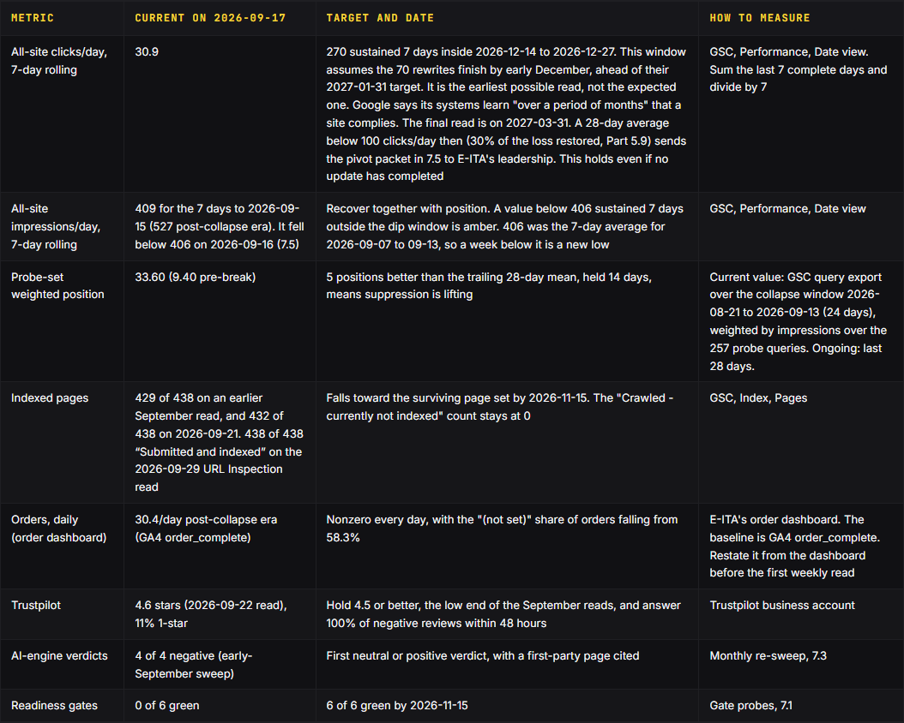
/winston
// 11 · scorecard
Scorecard.
Part 7 sets the scorecard in advance, with 6 readiness checks and the weekly numbers.
These rules decide what the numbers mean. They are fixed in advance so no one re-reads them after the fact.
e-ita.org · recovery audit · september 2026
53

Slide 54
/winston
// 11 · the checks
The weekly and monthly checks.
Run these every Monday. GSC data inside the last 72 hours is partial. Read through the latest complete day only. Clicks/day vs the 30.9 baseline. Sum the last 7 complete days. Divide by 7. Compare to 30.9, the post-collapse floor, and to the 270 plateau path.
Index coverage. Record total indexed. Expect the count to fall toward the surviving page set during 2026-10-19 to 2026-11-15. A rise in 'Crawled - currently not indexed' among kept or rewritten pages is a stop signal. Why: none of the 438 monitored URLs sat there on 2026-09-29, so a kept page landing there means Google read it and refused it. If it happens, pause the rewrite schedule and inspect the first affected URLs.
Review velocity. Record new reviews, the 1-star share (baseline 11%), and the reply rate on negatives (target 100% within 48 hours).
Order tracking. E-ITA's order dashboard, daily. Zero on any day is a tracking alarm, not a sales event. In GA4, record the '(not set)' share of orders. It is 58.3% today (Part 5.5). Above 65% is amber, because attribution is getting worse. A falling share means attribution is recovering.
On the first Monday of each month, ask ChatGPT, Gemini, Perplexity, and Claude the early-September questions again. Log 3 things per engine: the verdict, the sources it cites, and whether any first-party page is cited. A gate that was green and turns red is a deploy regression. Fix it before any new work ships. Compare to 33.60, the collapse-window value, and to 9.40, the pre-break reference.
e-ita.org · recovery audit · september 2026
54

Slide 55
/winston
// 11 · decision rules
Decision rules.
Lift candidate. The 7-day rolling clicks/day rises more than 20% above the trailing 28-day mean. It also stays above the 30.9 floor. It holds 7 or more days, confirmed only after a named update completes. A rebound from the expected dip alone is not a lift. This rule is the only authority for declaring recovery. Why 20% and 7 days: the June 2026 update cut clicks 22.4% over its 3-day window, then rebounded within 4 days (Part 2.3c).
Expected dip. It starts with the stage 4 deploy and lasts about 7 weeks. In the recommended order that is 2026-10-19 to 2026-12-06. Clicks below the 30.9 floor are expected in that window while kills and folds leave the index. It is amber if the 7-day rolling value falls below 15 for 7 straight days. It is red if it stays below 15 for 14 days. In that case, audit redirects and tracking first.
5 positions better than the trailing 28-day mean, held 14 days, means suppression is lifting. Probe impressions stay at or below 1,269 per day on each of those days. No named spam or core update is mid-rollout in the window.
Brand guardrail. Brand weighted position beyond 10.8 sustained 14 days is amber, and beyond 15 is red. A brand slide re-opens the cause assessment and pauses all recovery reads.
Pivot trigger. It is evaluated 28 days after the first named update that completes 28 or more days past a fully green redirect map. Condition 1: generic recovery is below half of brand recovery. Condition 2: rewrite-cohort pages earn 10 or more generic clicks/day while keep-cohort pages earn under 5.
Never report a number you did not verify. A reading pulled more than 3 days ago is stale. A check that cannot run reports 'unknown', never 'green'. A gate that passed and later fails is a regression alarm, not a fluke.
e-ita.org · recovery audit · september 2026
55

Slide 56
/winston
// next steps
Your first 14 days.
Freeze the page set. Publish no new country or locale page that the plan does not name. Ship the claims fix. Set the measurement rules. Ship 15 redirects now, and only those 15.
Next: Phase 1 begins. Name the authors and reviewers. No rewrite ships without them. Publish an About page and a real contact page. Start the reviews program.
The recommended targets are these: every row of the redirect map working by 2026-11-15, and all 70 rewrites live by 2027-01-31. Recovery is judged against thresholds set before any recovery data existed, with a final read on 2027-03-31 (Part 7).
Read Search Console movement only after Google marks the September 2026 spam update complete on its status page.
e-ita.org · recovery audit · september 2026
56

